Slide 1
Thriving Together in 2023
#AISThrive

Slide 2


Slide 3


Life.Work.Leisure

Slide 4


Consumer Groups
3 macro consumer groups will react in different ways to the polycrisis.
(the decline in economic stability, a decline of social + political harmony, the environmental crisis and the war in Ukraine)
Focusing on understanding their common concerns will help you develop a retail experience of broad appeal.
'See' your store through the eyes of a consumer to future-proof your business.
Clarity
Stability
Wellbeing

Slide 5

CLARITY
Clarity ... & Trust
The Issues
Consider key concerns & an increasing level of scepticism, distrust & disillusionment in society.
A huge decline in trust.
A strong ‘broken-system’ sentiment
Concern about systemic inequality
Concern about social justice, disinformation, corruption, repression of freedoms + rights.

Slide 6
CLARITY
Clarity ... & Trust
Solutions in Retail
Establish trust through action
De-clutter your store
De-clutter online presence
Visual consistency
Simplify messaging
Simplicity in store design, product & navigation
Online activity: clear, singular, honest, authentic
Support your local community: time, effort, help

Slide 7
STABILITY
Stability
The Issues
Consider key concerns
Risk in all things
Financial instability & uncertainty
Repression of freedoms and rights
The environment and climate change
Living in a world full of anxiety, conflict, division, and crisis
Inaction, turmoil, threat

Slide 8
STABILITY
Stability ...
through Product & Service
Solutions in Retail
Product physically + visually communicate stability.
Understated Product that's effortlessly good-looking, and stylish.
Repairable, reusable, recyclable.
Faded, rustic, distressed to communicate humanity, honesty, longevity.
Vintage design introduces a nostalgic emotion.
Personalisation of service & product
Product clearly inspired by Nature in material, pattern, colour + shape.

Slide 9
WELLBEING
Wellbeing
The Issues
A torrent of bad news
Increased levels of anxiety, stress & depression in society
Increasing lack of tolerance + acceptance
Fear about failing health systems

Slide 10
WELLBEING
Wellbeing
Solutions in Retail
Open, airy, clean, light spaces.
Signage: use words & images referring to states of wellbeing achieved through use of ...
Lifestyle merchandising
Zones: unexpected, magical, wondrous, safe, organised, community, collaborative, inclusive,
New product, displays, sectors.
A space that's nature inspired, filled, lived & connected
Inspire creativity, freedom, control
Clearly connect to 'local community' – the window space
Community activity ... Tea 'n coffee around a kitchen table, in an art zone ...

Slide 11

SPACE TO BREATHE

Slide 12
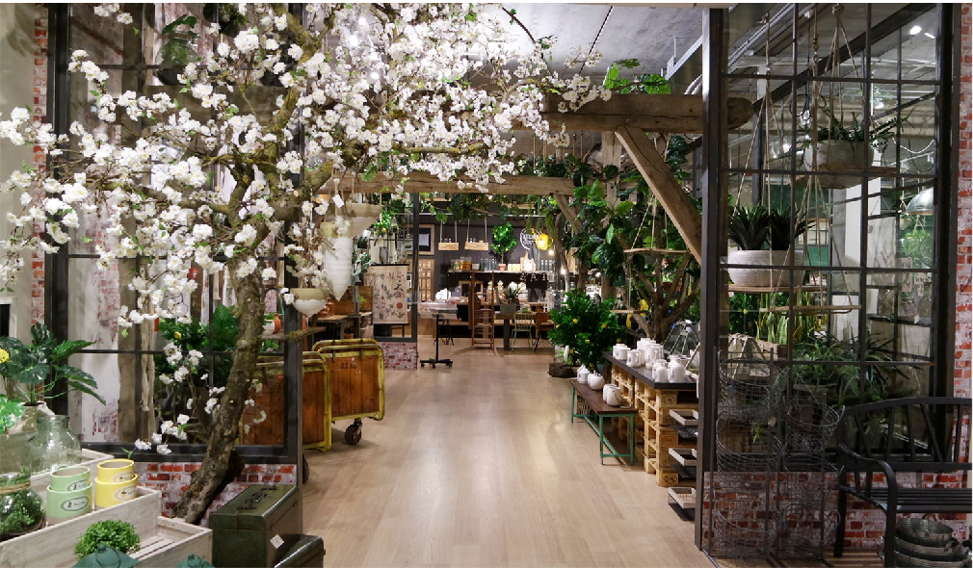
THE CONSUMER JOURNEY
The more senses awakened, the more memorable, inclusive, engaging and successful the experience … for everyone.
IMMERSIVE EXPERIENCE
SIGHT, SOUND, TOUCH, SMELL, TASTE

Slide 13

Building a Better Future
We provide Foresight+Trend intelligence to help you rethink and reform your approach to product development, marketing and brand strategy.
This presentation is protected by International Copyright laws.
Reproduction, distribution, display and use of the presentation is prohibited without prior written permission being received from a Director of the company.
© Scarlet Opus Limited 2023
www.scarletopus.com/subscribe phil@scarletopus.com

Slide 14
Thriving Together in 2023
#AISThrive

Slide 15


SPRING/SUMMER
24
Notes:
Welcome I’m JK and Im going to talk you through USP who we are, what we do and some of the key trends that will be important for SS 24

Slide 16
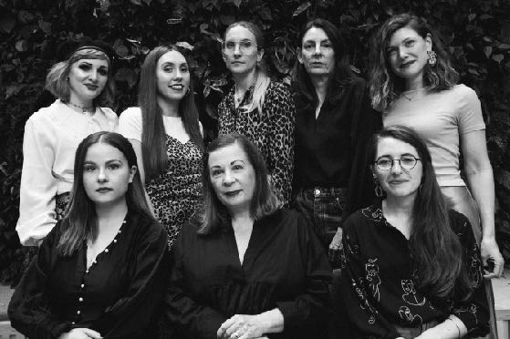
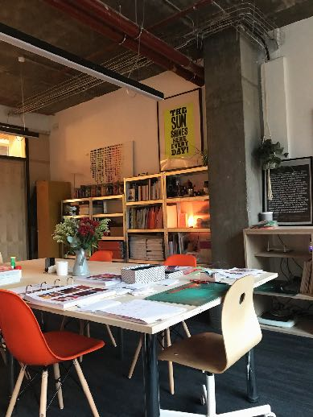
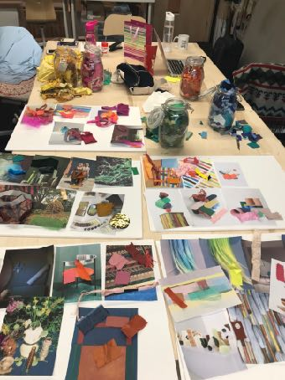
WHO
INDUSTRY EXPERTS
STRATEGIC THINKERS
FUTURE INNOVATORS
CULTURAL OBSERVERS

Slide 17

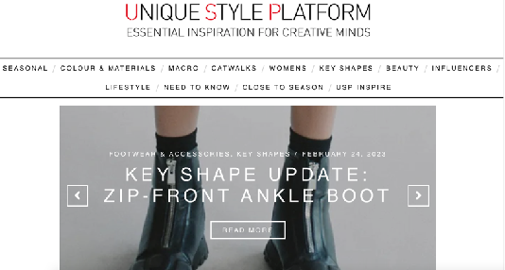
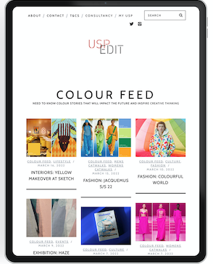
WHAT
FUTURE & BESPOKE FORECASTS
COLOUR FORECASTS & UPDATES
MACRO TRENDS & UPDATES
PRODUCT DIRECTIONS
PRINT & FABRIC REPORTS
CATWALK ANLYSIS
TRADE SHOW COVERAGE
CLOSE TO SEASON &
NEED TO KNOW REPORTS
WEBINARS & EVENTS
www.uniquestyleplatform.com
www.edit.uniquestyleplatfrom.com
Notes:
So what do we do.
With our website we have created an easy to navigate website with digestible, inspiring content, as well as the physical tools required to make trends real – such as downloadable hi res images and actual colour swatches. Social media means trends are accessible to everyone and creative teams are more than capable of forecasting their own, but what they don’t have is time.
Our job is to trawl through the vast amount of information and make sense of it in an inspiring and tangible way.
We cover …..

Slide 18
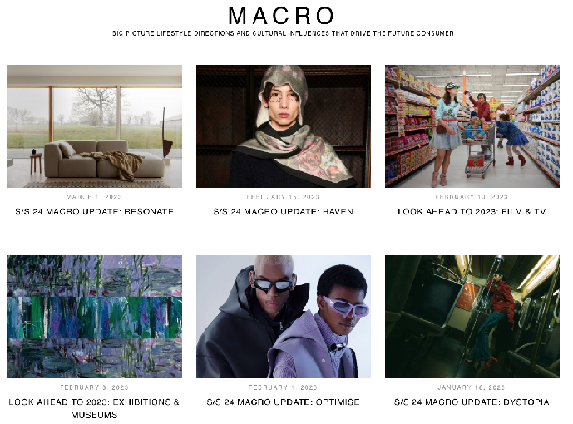
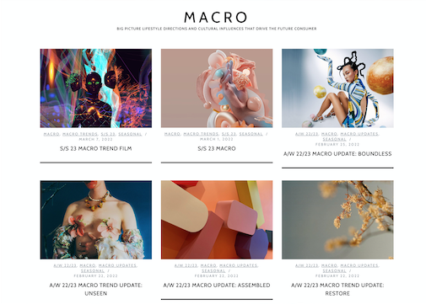
WHY
INSPIRE CREATIVE THINKING & ENCOURAGE INNOVATION
GAIN AN EDITED ANALYSIS OF FUTURE & CURRENT TRENDS
CONFIRMATION OF IDEAS
MONOTOR THE EVOLUTION OF ONGOING TRENDS
ENCOURAGE CROSS COMPANY THINKING
CREATE NEW OPPORTUNITIES
STAY AHEAD OF THE COMPETITION
MINIMIZE RISK
Notes:
And why do our clients work with us ?

Slide 19
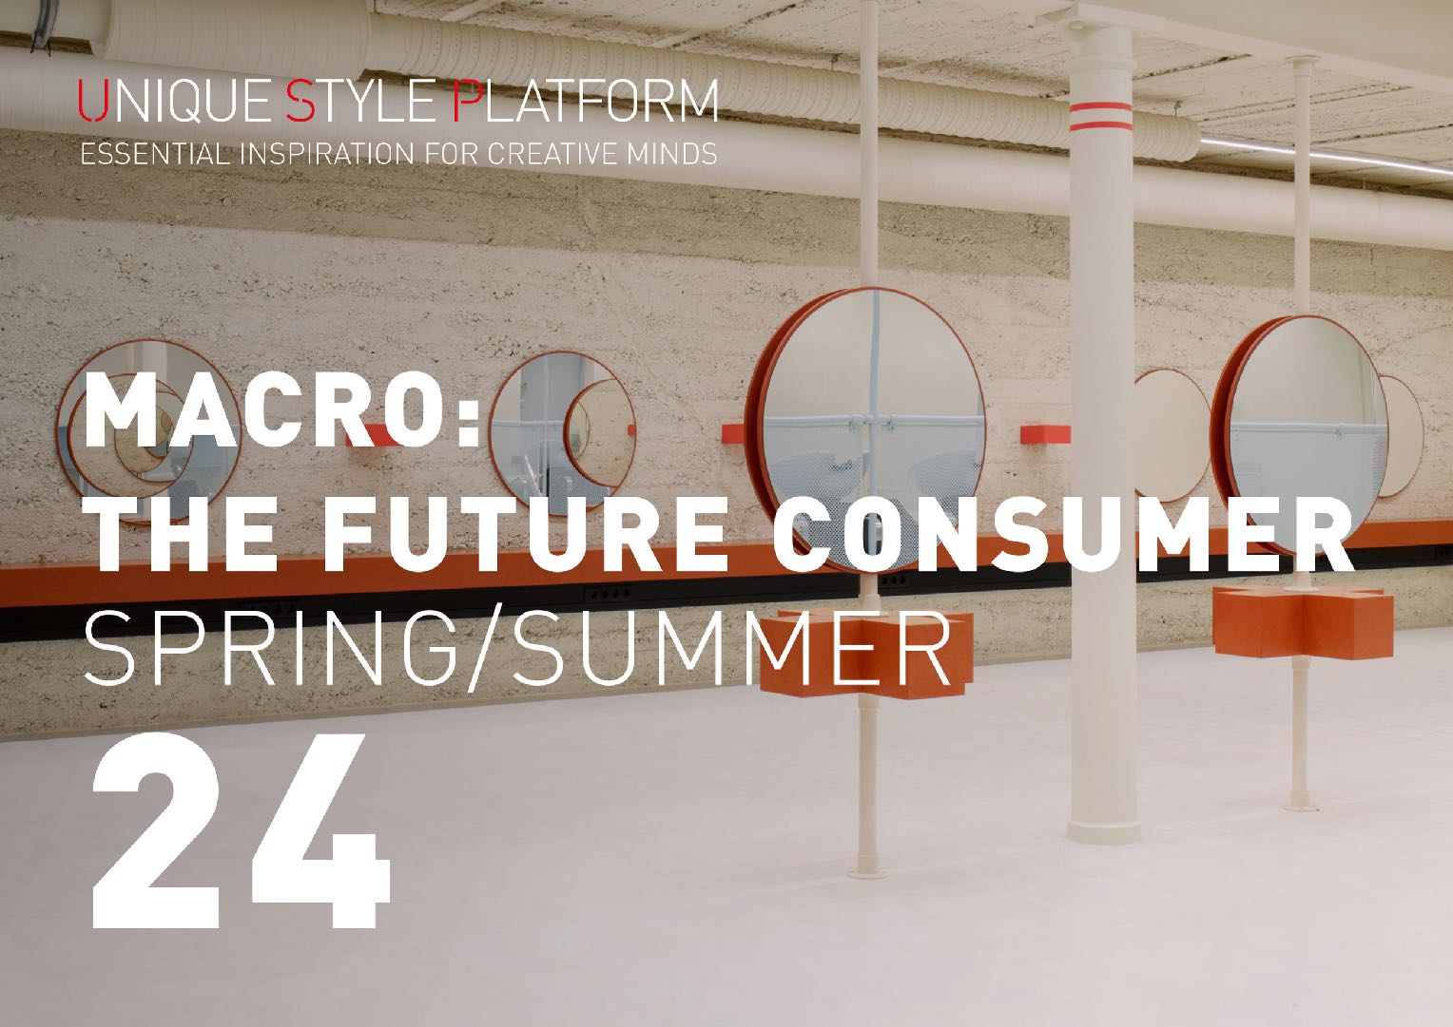

Slide 20
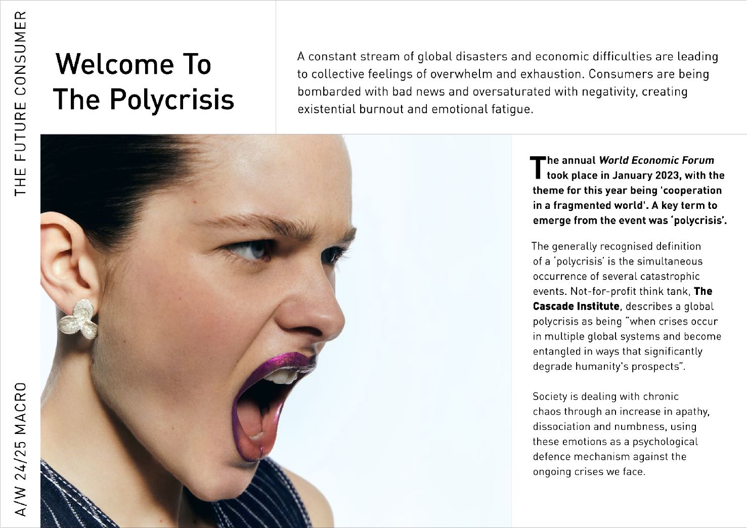

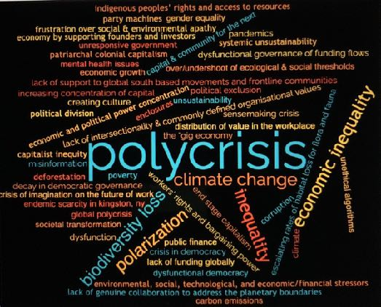
Notes:
POLYCRISIS is a term that emerged from the The annual World Economic Forum - that describes the series of global disasters and economic difficulties are leading to collective feelings of overwhelm and exhaustion.
Consumers are bombarded with bad news and oversaturated with negativity and this is creating burnout, emotional fatigue and an increase in apathy, dissociation and numbness.

Slide 21
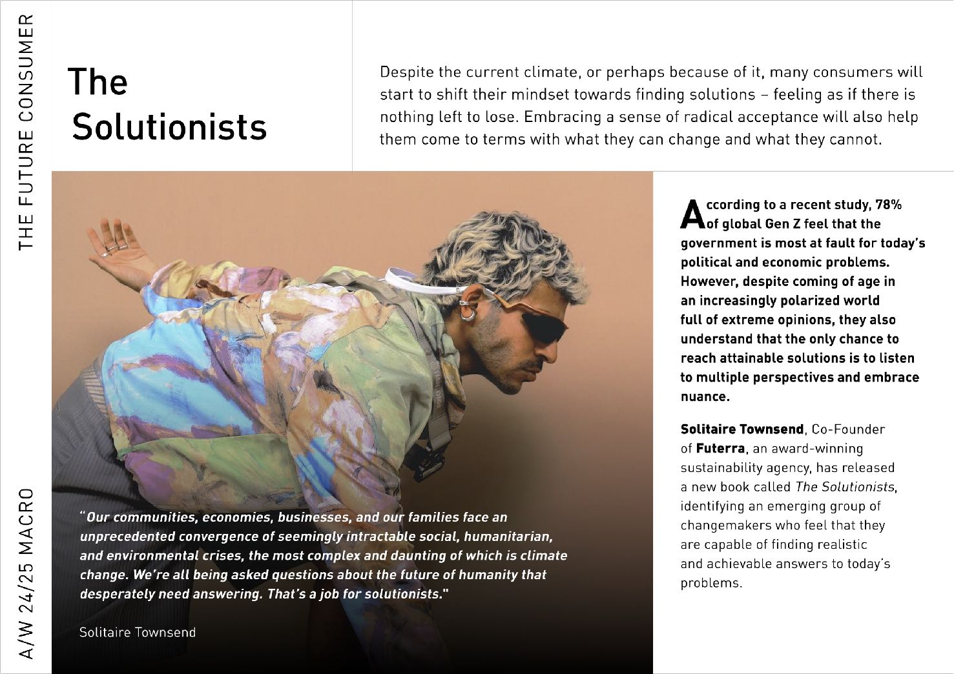
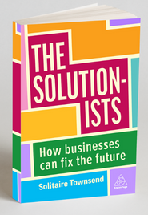
Notes:
Many consumers will start to shift their mindset towards finding solutionsan and embrace a sense of acceptance in order help them come to terms with what they can change and what they cannot.
Solitaire Townsend, Co-Founder of Futerra, an award-winning sustainability agency, has released a new book called The Solutionists, identifying an emerging group of changemakers who feel that they are capable of finding realistic and achievable answers to today’s problems.
Retailers and brands also need to consider how to find solutions and help consumers with these feelings of overwhelm

Slide 22
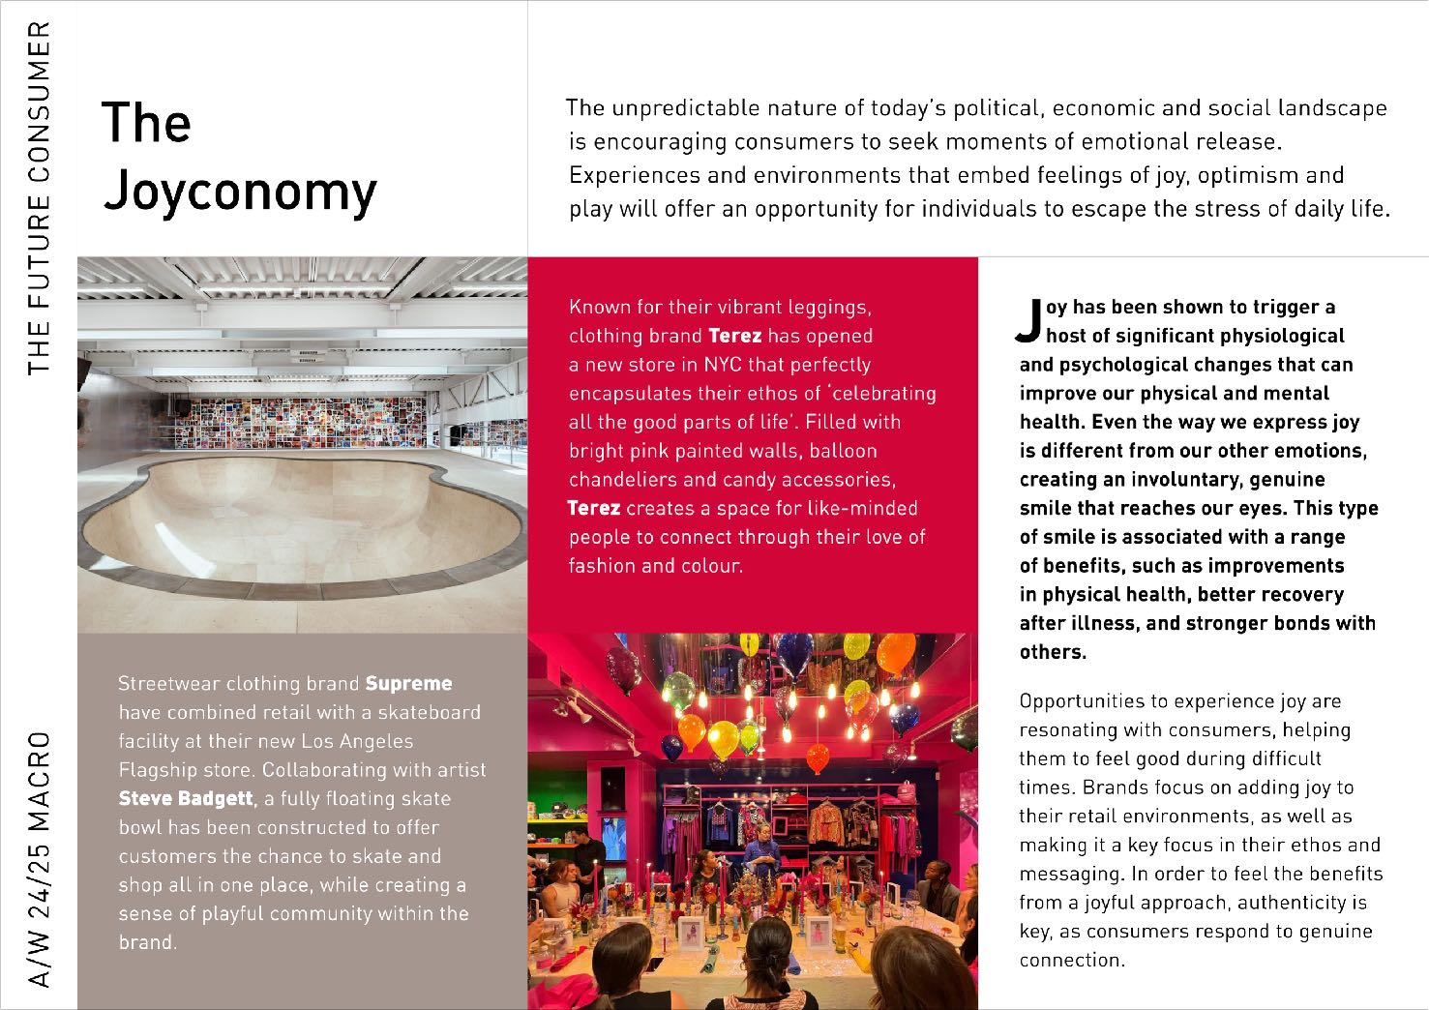
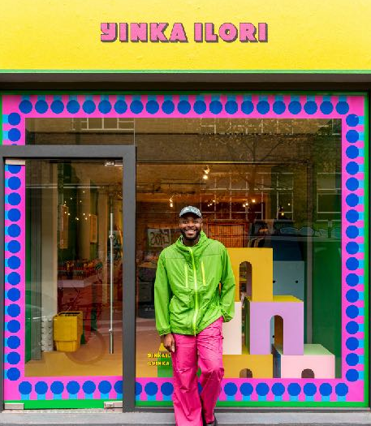

Notes:
Offering up moments of joy, optimism and play through experiences, collaborations, environments and play, helps consumers escape the stresses of daily life. Its also important that brands make joy and authenticity a key focus in their ethos and messaging as consumers respond to genuine connection and authentic marketing.
Examples include
Streetwear brand Supreme combining retail with experience- by including a fully floating skate bowl in the shop – offering consumers a chance to shop and skate, while also creating a sense of community.
NYC Legging brand’s new store encapsulate their ethos of capturing all the good parts of life. The brightly painted interior is filled with fun balloon chandeliers and quirky accessories connect consumer with their love of fashion and colour.
And the amazingly joyful artist Yinka Llori has collaborated on a number of joyful collaborations with brands such as Lego, Marks & Spencer, lick paints and the Conran shop among others

Slide 23
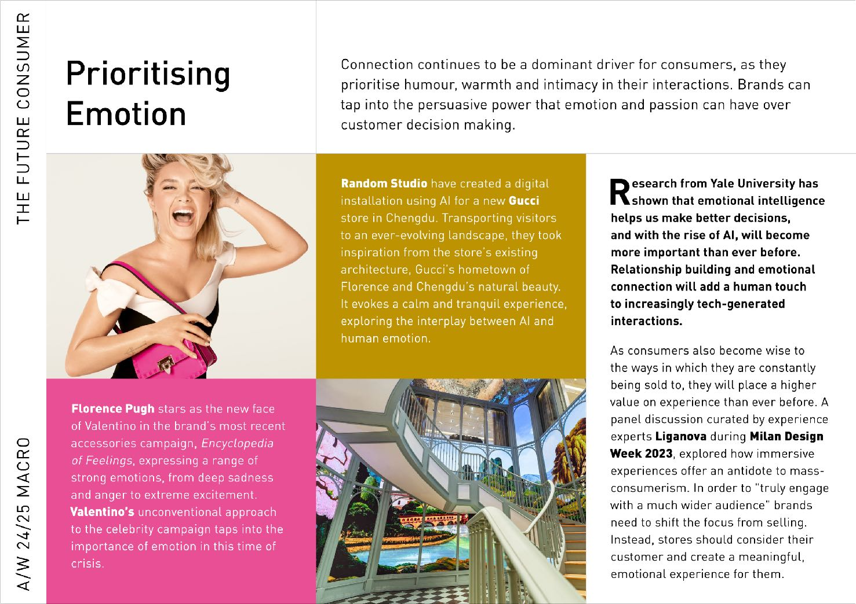
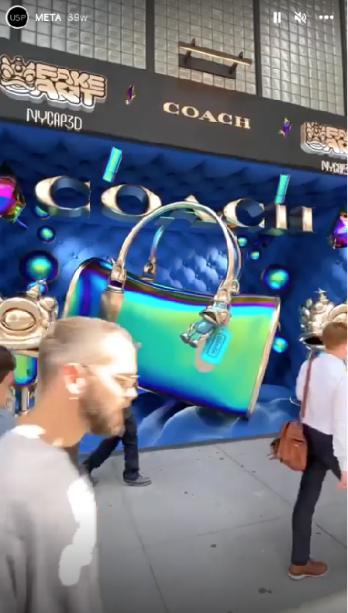
Notes:
Prioritizing emtotion continues to be a key driver for consumers as they prioritise humour, warmth and intimacy in their interaction with brands. Brands can tap into this by embedding emotion into advertising, marketing, products and retail experiences,
Florence Pugh is the new face of Valentinos newest accessories campaign – called encyclopedia of feelings – that expresses a strong range of emotions from deep sadness to extreme excitement..
and AI and tech can help brands to create interactive experiences such as guccis digital installation in china that transports shoppers through ever evolving landscapes and to celebrate a successful drop of their NFT collection the brand created an immersive AR video in their 5th avenue flagship store window.

Slide 24
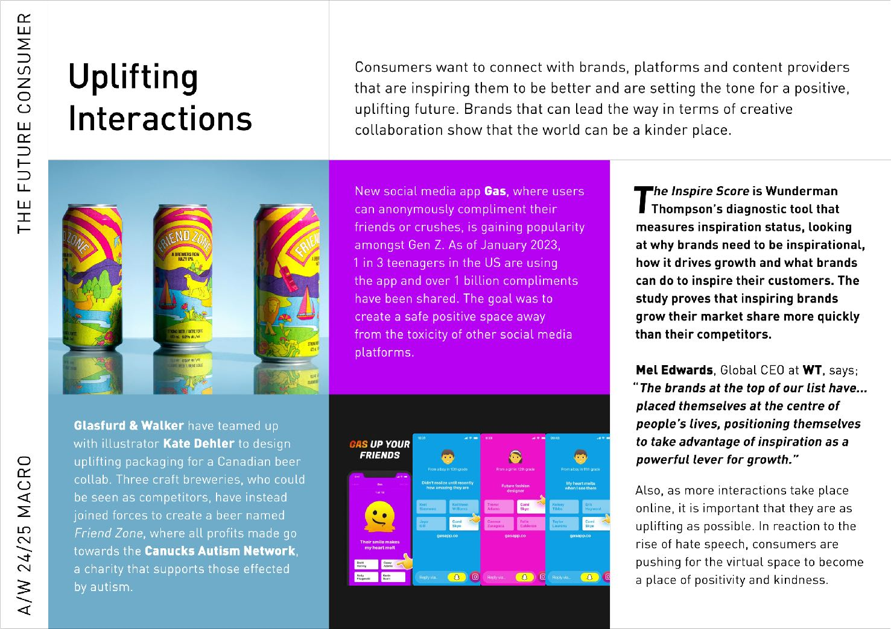

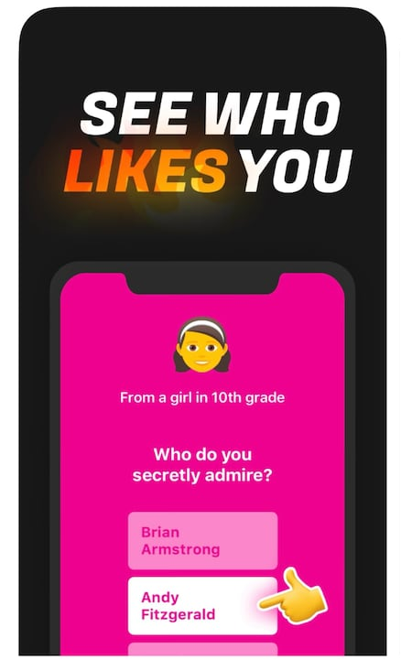


Notes:
Creating uplifting interactions is also a key consideration for retailers moving forward as consumers want to connect with brands or platforms in a positive way.
Creative collaborations and giving back are great ways to do this and some examples include
The Canadian brewery on the left who collaborated with illustrator Kate Dehler to design uplifting packaging for their create Friend Zone beer., where are the profits e go towards a charity that supports those effected by autism.
and
A new social media up growing in popularity with gen z, where users can anonymously compliment their friends or crushes.

Slide 25
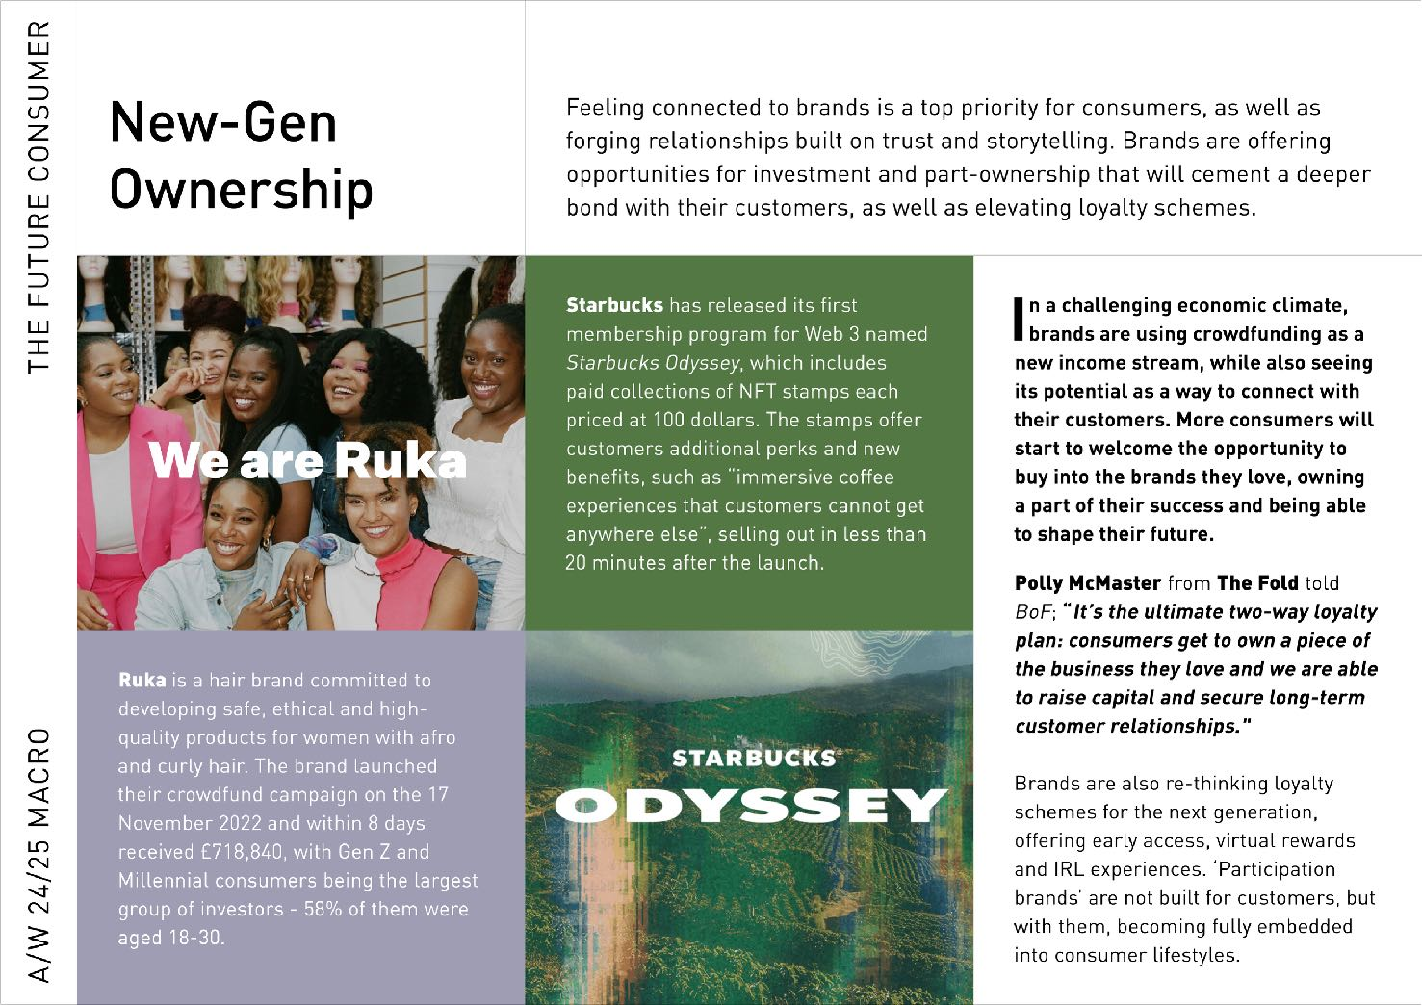
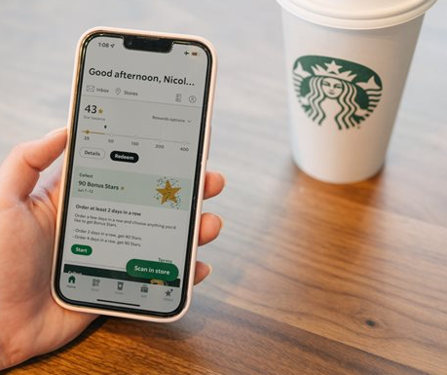
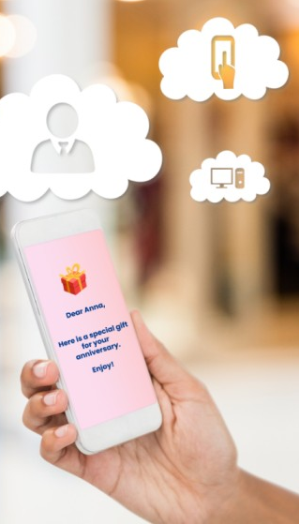
Notes:
Feeling connected and forging relationships with brands is an increasingly important priority for consumer. . Clever brands offer opportunities for investment and part-ownership that will cement a deeper bond with their customers.
Ruka is a hair brand committed to developing safe, ethical and high-quality products for women with afro and curly hair. The brand launched their crowdfund campaign inNovember 2022 and within 8 days received £718,840, with Gen Z and Millennial consumers being the largest group of investors
Starbucks has released its first membership program for Web 3 named Starbucks Odyssey. The program sold out in less than 20 minutes after the launch. It includes paid collections of NFT stamps each priced at 100 dollars., that offer customers additional perks and new benefits, such as “immersive coffee experiences that customers cant get anywhere else”.

Slide 26
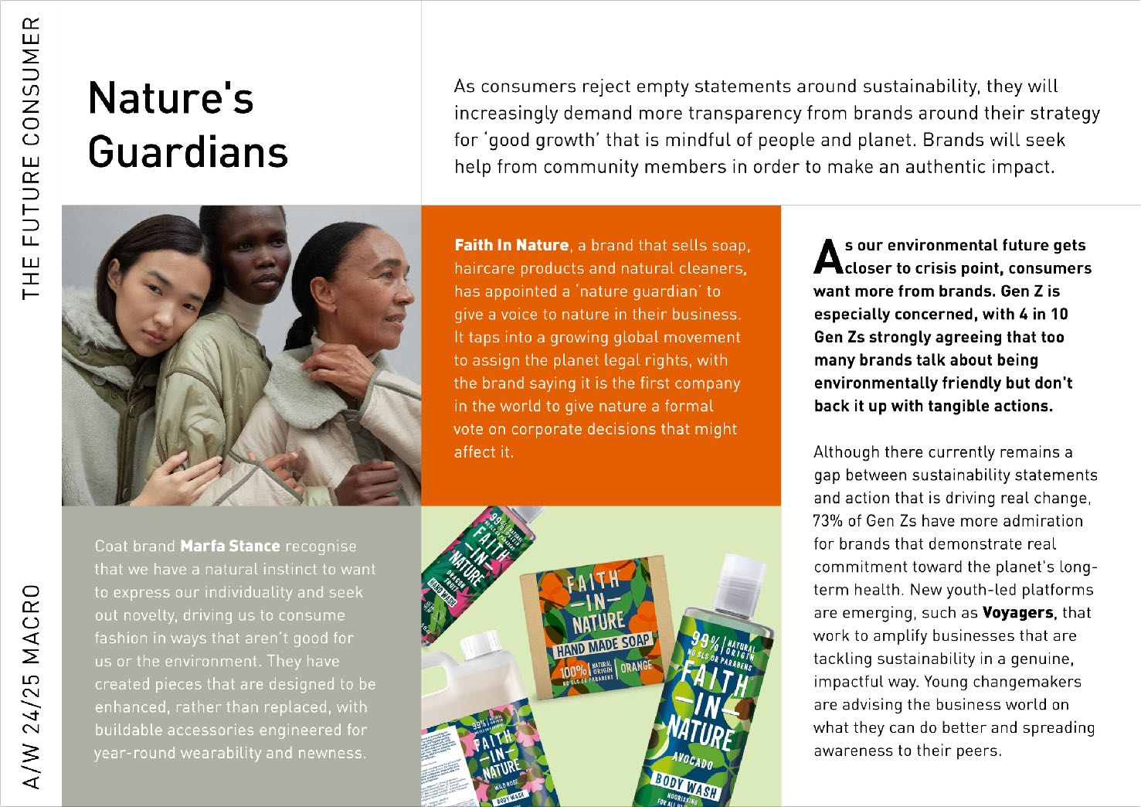
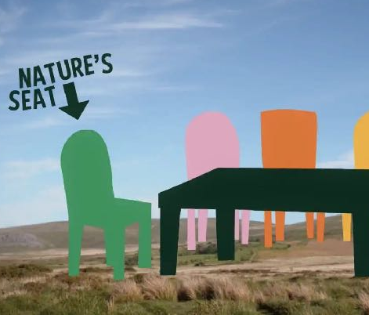

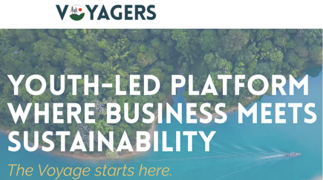
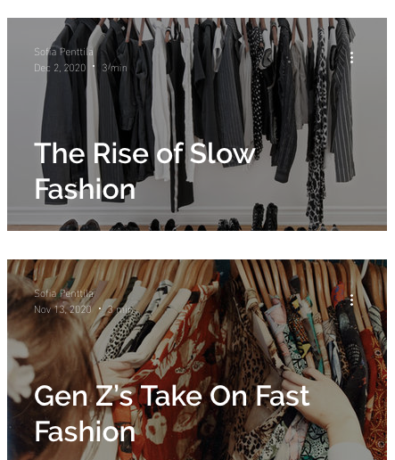
Notes:
As consumers reject empty statements around sustainability, they increasingly demand more transparency from brands around their strategy for ‘good growth’ that’s mindful of people and planet. Brands seek help from community members in order to make an authentic impact. For example
Voyagers is a new youth led platform that’s tackling sustainability in a genuine, impactful way, and enabling young changemakers to advise the business world on sustainability what they can do better.
Soap and cleaning brand Faith In Nature, has appointed a ‘nature guardian’ to give a voice to nature in their business. The brand claim to be the the first company in the world to give nature a formal vote on corporate decisions that might affect it.
And Coat brand Marfa Stance recognize that our desire for fashion isn’t necessarily good for us or the environment and have created pieces that are designed to be enhanced, rather than replaced, with add-on accessories designed for year-round wearability and newness.

Slide 27
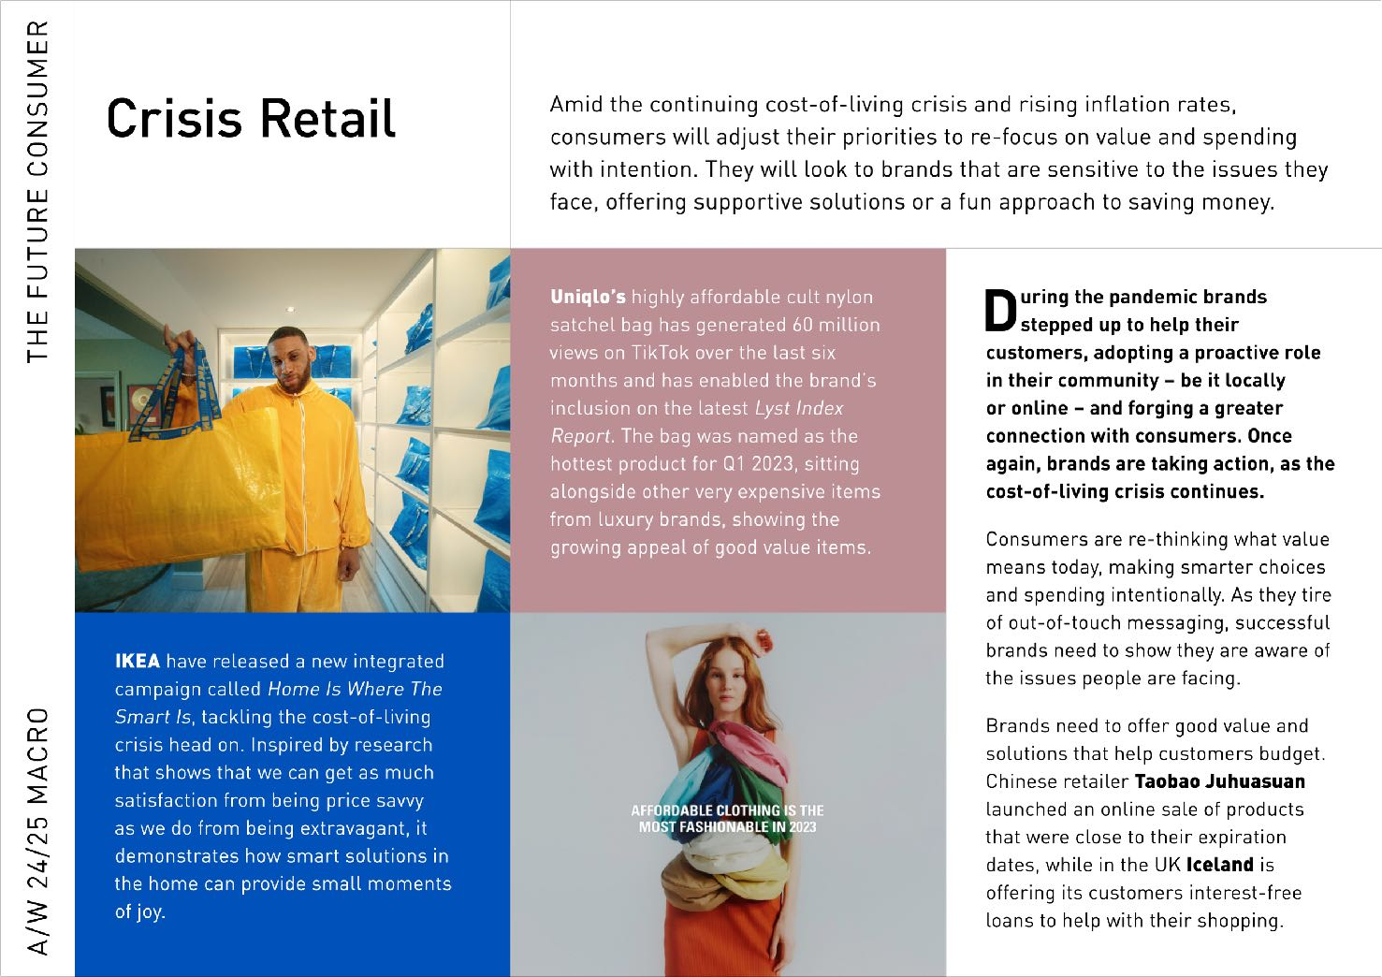
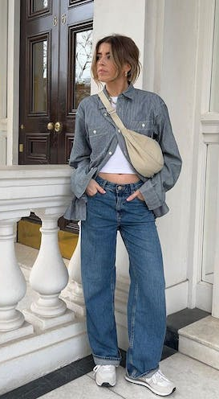
Notes:
As a reaction to the cost of living crisis or the cossie livs as it has been rebranded by gen Z. Consumers look to brands that are sensitive to the issues they face buy offering supportive solutions or funs solutions to saving money.
Ikea have a new campaign called Home is where the Smart is, that helps consumers to gain satisfaction from being price savvy while still bringing joy.
And Uniglo have seen massive success with their value cult cult nylon bag that costs £14.90 –named the hottest product for Q1 2023. illustrating the growing appeal of a good value style.

Slide 28
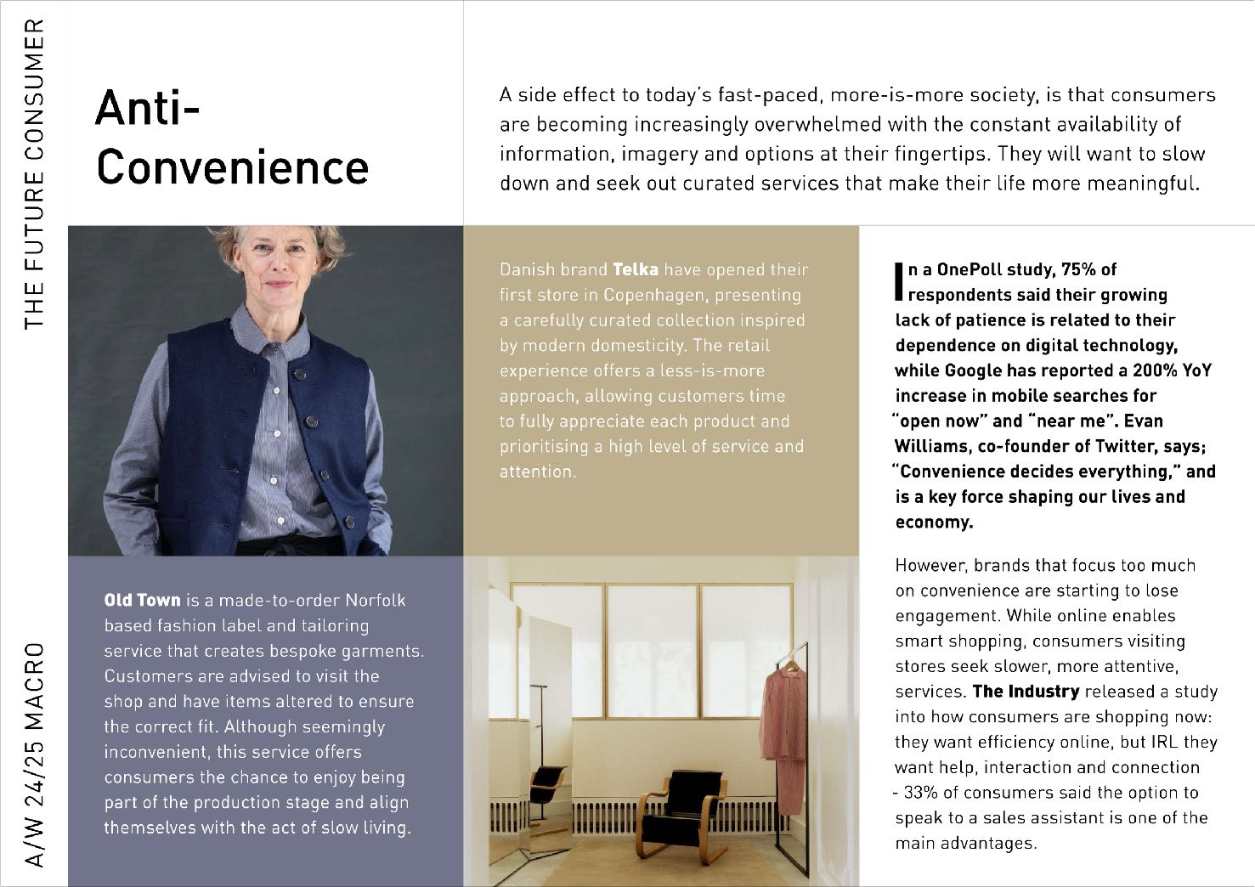
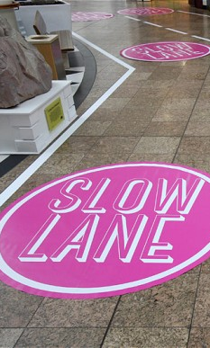
Notes:
And finally - a side effect of today’s fast-paced, more-is-more society, sees consumers become increasingly overwhelmed with the constant availability of information, imagery and options. Theyy increasingly want to slow down and engage with curated services that make their life more meaningful.
Danish brand Telka have opened their first store in Copenhagen, presenting a carefully curated collection inspired by modern domesticity. The retail experience offers a less-is-more approach, allowing customers time to fully appreciate each product experience a high level of service and attention.
And
Old Town is a made-to-order Norfolk based fashion label and tailoring service that creates bespoke garments. Customers are advised to visit the physical shop and have items altered to ensure the correct fit. Although seemingly inconvenient, this service offers consumers the chance to enjoy being part of the production stage and align themselves with the act of slow living.

Slide 29
THANK YOU
Notes:
Welcome Im JK and Im going to talk you through USP who we are, what we do and how we could help you across some or all of your businessses

Slide 30
Thriving Together in 2023
#AISThrive

Slide 32
Upcoming Legal Requirements
The Cost of Getting it Wrong
Challenges
Partnerships
Commitments & Drivers

Slide 33
Following a long period of inactivity, the UK is set to introduce several significant changes to employment law in the coming years
Three key proposals unveiled in the Chancellor’s Spring Budget
Five key proposals related to Employment Bills
Understanding these changes is essential for us to ensure we remain compliant with the law, and support employees in the best possible way
Legal change is coming
Notes:
Lets start with a light touch on what's coming up in legislation changes – you wont want me talking through legislation for the next 20 mins!
Three key proposals unveiled in the Chancellor’s Spring Budget which aim to keep people in employment, and promote their return to work, through enhanced accessibility to childcare, improved support for disabled people in the workplace, and ‘returnership’ initiatives targeted at those who have withdrawn from the workforce
The second section covers five key proposals related to Employment Bills that are currently being discussed in Parliament, many of which stand to enhance the rights of working parents and carers
Understanding these changes is essential for us to ensure we remain compliant with the law and support our employees in the best possible way

Slide 34
Measures to enhance the accessibility to childcare
Improved support for disabled people in the workplace and measure to help long-term sick and disabled people back in to employment
‘Returnships’ for the over-50’s
UK Spring Budget
Notes:
Measures to enhance accessibility to childcare
Currently, around 435,000 parents in England are not working due to their caring responsibilities for children under three years of age - From April 2024, working parents of two-yearolds will be able to access 15 hours of free childcare per week, benefiting parents of up to 285,000 children.
From September 2024, this will be extended to working parents of children aged nine months to two years, benefiting parents of up to 640,000 children. • From September 2025, all eligible working parents of children aged nine months to three years will be able to access 30 hours of free childcare per week.
Improved support for disabled people in the workplace and measures to help long-term sick and disabled people back into employment - The background: Conditions such as back pain and neck and upper limb problems, known as musculoskeletal disorders or MSDs, can result in considerable time off work. In fact, in 2021, MSDs accounted for 13.4% of all sickness absences, resulting in 23.3 million days lost. - timeframe for implementation remains unknown, but changes will be beneficial to businesses and their employees
‘Returnerships’ for over-50s - The background: UK businesses have been battling severe worker shortages over the past two years, partly due to high numbers of people over 50 leaving the workforce.
Between May and July 2022, there were 386,096 more economically inactive adults aged 50 to 64 years than in the pre-pandemic period. The government’s returnership proposals offer a structured and supportive pathway back into the workforce and could help to promote greater diversity and inclusion, fill skills gaps, and address labour shortages in certain industries

Slide 35
Making flexible working the default: The Employment Relations (Flexible Working) Bill 2022/23
Extended redundancy protection for new parents: The Protection from Redundancy (Pregnancy and Family Leave) Bill 2022/23
A week’s unpaid leave for carers: The Care’s Leave Bill 2022/23
Additional leave and pay for employees with children receiving neo-natal care: Neonatal Care (Leave and Pay) Bill 2022/23
Scrap certain EU Law: Retained EU Law (Revocation and Reform) Bill
Employment Bills
Notes:
The legal bit…..all very fluid and not yet law
Many of the employment-related Bills currently making their way through Parliament have been on the table for several years; however, with the COVID pandemic largely behind us and a general election looming, there appears to be a real push towards a successful outcome, meaning we could see some legislative changes implemented in 2023. While there are no guarantees in terms of introduction dates, here are five key proposals to keep on your radar this year
Making flexible working a day one right. This would mean that employees won’t need to have completed 26 weeks’ service before making a request, as they currently do. • Requiring employers to consult with the employee if they may reject the request. Note that this is already considered best practice, so is unlikely to change much. • Allowing employees to make two requests in any 12-month period, rather than one. • Reducing the timeframe for dealing with a request from three months to two months. • Removing the current requirement for employees to explain what effect, if any, the change they are requesting would have on the employer and how this might be dealt with. - No employee will have the right to demand a change to their hours or place of work.
2) Around 54,000 new mothers are forced out of their jobs in Britain each year. ntention to extend redundancy protection for pregnant employees until six months after the end of their maternity leave (currently, protection only covers the maternity period).
3) Bill would introduce the right to a week’s unpaid leave for carers - protected from dismissal or any detriment as a result of having taken time off. In 2020, the number of people in paid work who were also providing unpaid care increased to over 7 million – and, on average, 600 people a day leave work due to their caring responsibilities
4) This new right is expected to provide both parents with up to 12 weeks’ of paid leave and would be in addition to other leave entitlements, such as maternity and paternity leave – late 24/early 2025
5) EU – lots of changes here - The Bill will now be amended to contain a list of the retained EU laws that the government intends to revoke on 31 December 2023 - but anything not on that list will remain valid (for now)

Slide 36
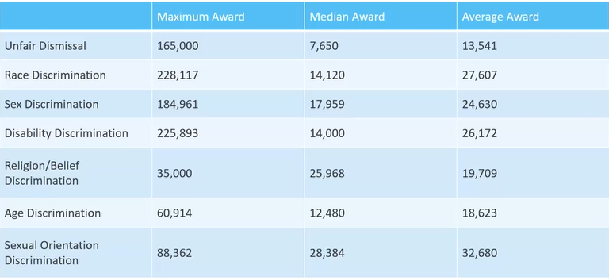
Cost of Getting it Wrong

Slide 37
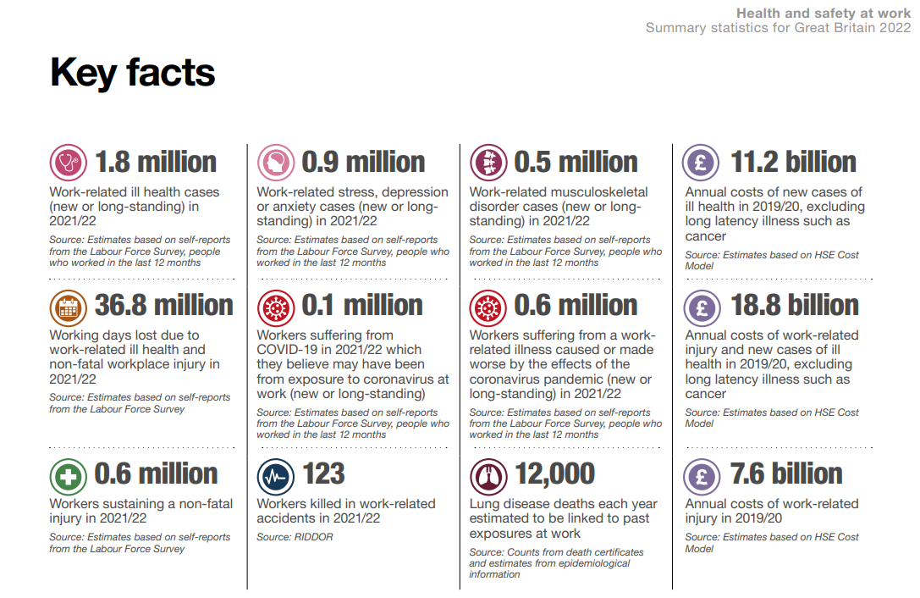
Cost of Getting it Wrong

Slide 38
Recruitment
Absence
Diversity
L+D
Succession
People Challenges
Notes:
Top tips and stats:
Recruitment
Diversity
Look out for Gov support
Prepare now for a more flexible workforce
Absence
Robust RTW procedures
Access to an EAP
Access to Occ Health
DiR
Access to courses
Access to webinars for all
Insights and Newsletters
Tooolkits
Succession
How to create succession within a family business

Slide 39




Partnerships
Notes:
The way forward – we will facilitate and explore partnerships
•In order to access specialist advice
•In order to be efficient, best value for money
Key question – normally legal
What courses – Course for that

Slide 40
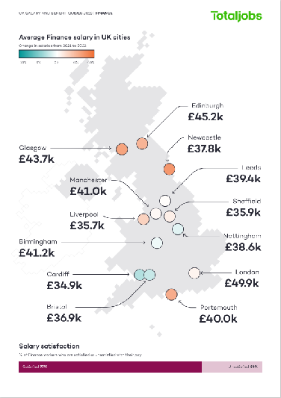
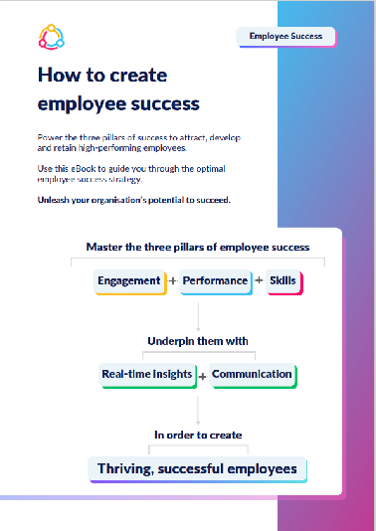

Adding Value with Partnerships
Notes:
Access to:
EAP services
Financial grants
Advice
Pay data
Toolkits
Newsletters – but I’m sure we all have enough of those 😁
Legal services
Training courses
Succession support
Webinars
Reports
And the list goes on so watch this space…….

Slide 41
https://vimeo.com/781044261?share=copy
Notes:
I’d like to share a short video on a recent Inclusion summit from Diversity in Retail

Slide 42
Commitments and Drivers
Find Partners
HR Forum/Network
L+D focus

Slide 43
Thriving Together in 2023
#AISThrive

Slide 44




















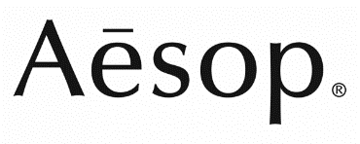









Q5. The art and science of organisational health.
Over the last ten years, we’ve partnered closely with business leaders from over
of the most prestigious brands and companies globally to support them in defining and improving their organisational health.
324
All Content © Copyright Q5 Partners
Notes:
We typically work with 35 retail organisations a year including FMCG, online and multi-channel retailers

Slide 45
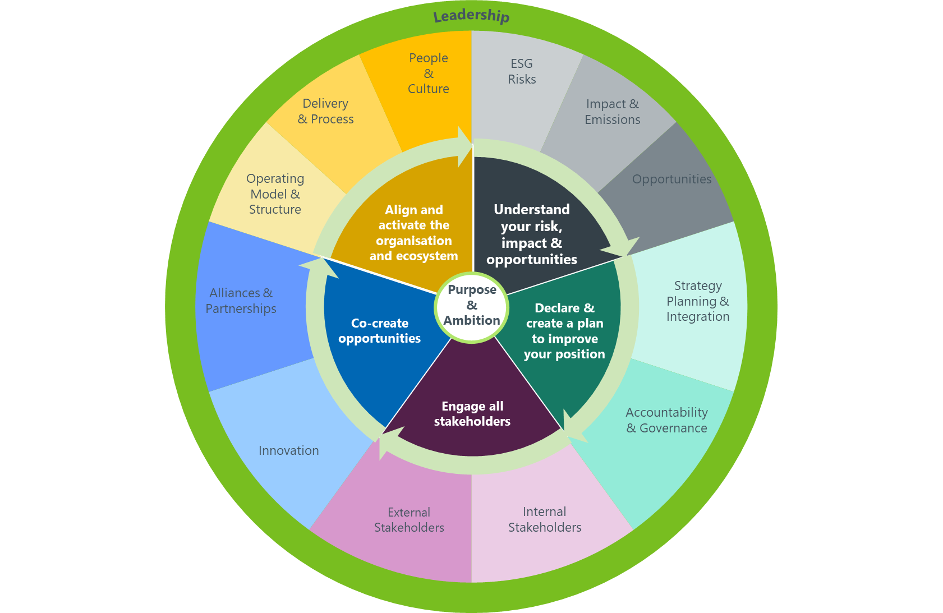
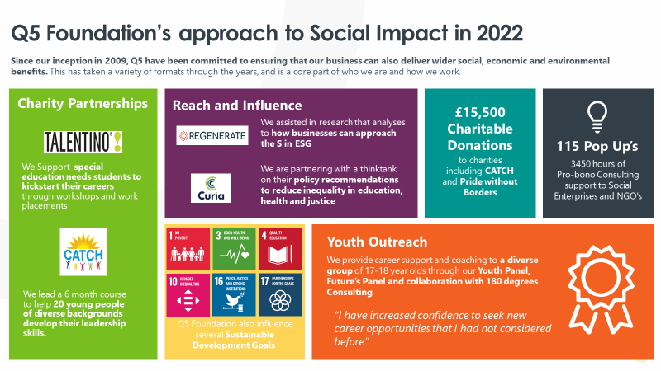
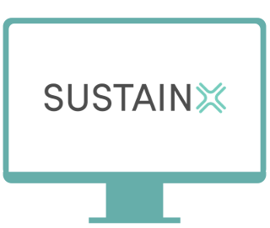
What do our clients use us for?
Moving from intent to action
Sustainability Transformation
Practical support
Insight-led
All Content © Copyright Q5 Partners
Notes:
Our sustainability work is supported by 3 main elements – advisory work on sustainability transformation, SUSTAINX platform and research collaborations/partnerships around social impact (e.g. Good Jobs project - most relevant for retail).
We offer a range of services from defining purpose and ‘making it matter’, through to maturity assessments, and transformation plans & support. This is supported by insight, support and guidance through our SustainX platform.
We’re exploring with AIS how and what we can offer to you too to ensure you’re confident and capable to face the challenges ahead.

Slide 46
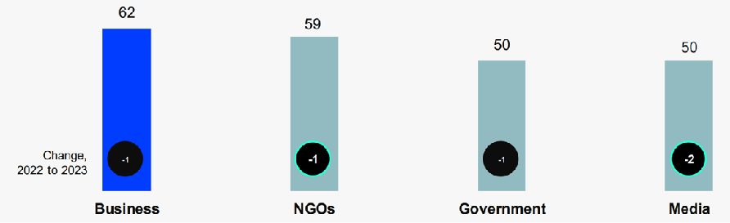
Industry 5.0 & the moral economy
From doing things right to doing the right thing
Businesses lead on trust Edelman Trust Report 2023
Human Centric
Sustainable
Resilient
All Content © Copyright Q5 Partners
Notes:
Many businesses are still grappling with 4.0 (AI, digital, IoT etc), but whilst many are still grappling with this Industry 5.0 is on its way, expectations of business are rapidly changing – shift from focus on economic to societal value (reference Edelman trust barometer, percentage trust globally and in UK only businesses were seen as competent and ethical). So we shift from ‘doing things right’ (machine/AI) to ‘doing the right thing’ (Industry 5.0)
7/10 CEOs believe traditional growth strategies are obsolete – as we enter the ‘moral economy’, so how to navigate this….
Industry 5.0 places well-being and the worker at the centre, whilst focussing on prosperity beyond jobs and growth that respects planetary boundaries (in other words a shift from focus on economic value to societal value)
In some ways this is nothing new – we’ve talked for some time about concepts such as triple bottom line, CSR etc, but what is new in industry 5.0 is that these concepts are at the core
So what does this mean for you? Industry 5.0 has 3 pillars – human centric, resilient, sustainable. So what are the shifts you need to consider…
Human-centric – prioritises the well-being and satisfaction of its employees, customers and wider community (John Lewis & care leavers example)
Resilient – how do you become anti-fragile? Resilient strategies are agile and flexible, but more than that its about the perspectives that inform your strategy – diversity is key here, and a culture of psychological safety/trust. Diverse perspectives, culture where people can speak up and longer-term mindset (e.g. Wales and future generations act example)
Sustainability – here the shift is to strategies that take action on sustainability and respect planetary boundaries (to date we have been very focussed on minimising harm and/or on purpose/greenwashing). This gets back to purpose, how is your business making the world a better place, not just reducing the damage you cause. Here we are seeing lots of industry collaborations (e.g. Daimler & Volvo, Railsponsible etc)
Could use the delta airlines story about trophy hunter….
Hear from some members about how they are tackling this – move to talking heads video
Introduce Jeremy to share some words of wisdom on ‘how’

Slide 47


EXPLORE THE HEAVENS
ORGANISE THE WORLD’S INFORMATION
ENRICH NOT EXPLOIT

Slide 48



ON
AMPLIFY
OFF

Slide 49
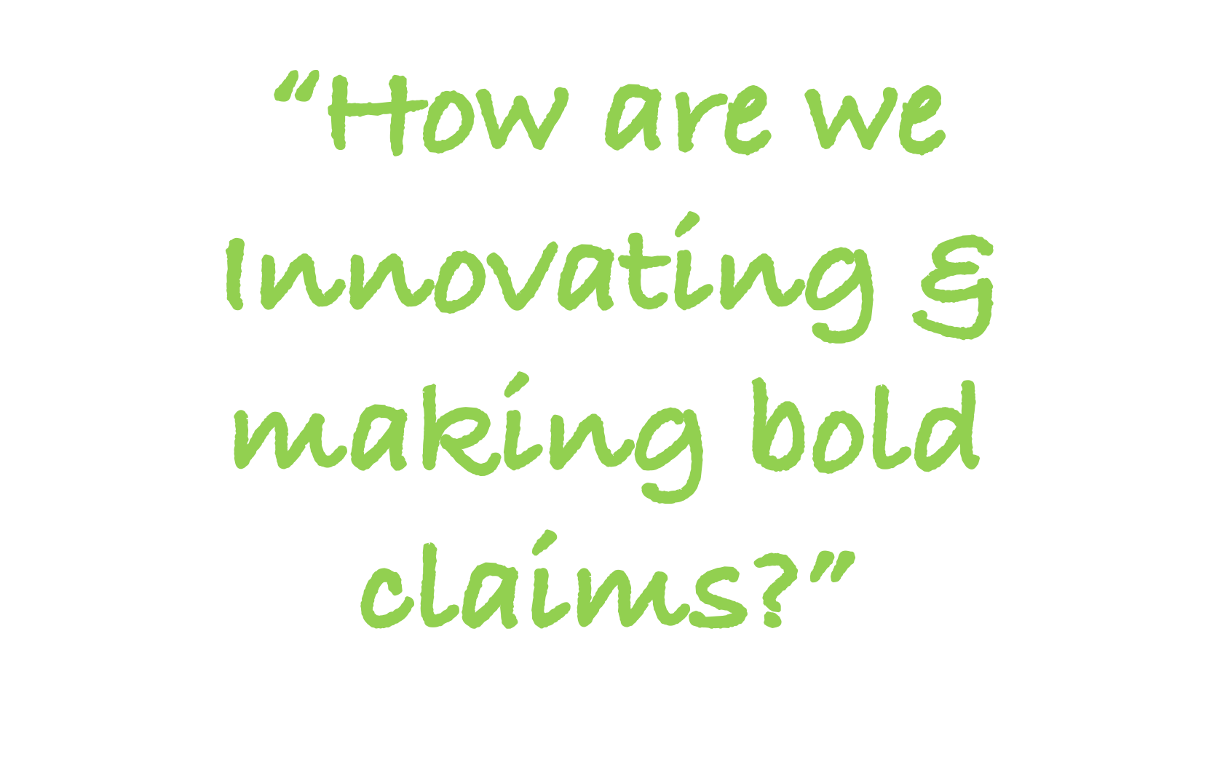

QUESTIONS
KILLER

Slide 50




Slide 51
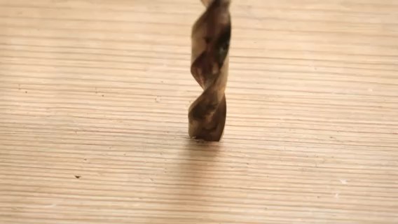



Slide 52




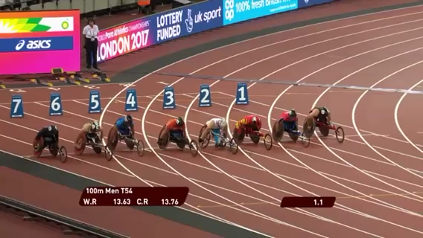


Slide 53
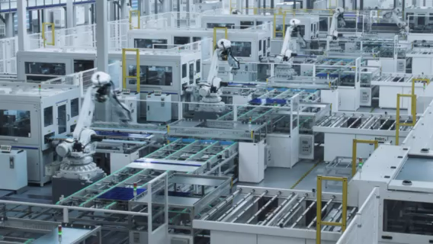
THE SCIENCE BIT
Social Concern
Brazil
Columbia
2.0
Mexico
Germany
1.5
US
India
UK
France
Spain
Kenya
1.0
Philippines
China
0.5
South Korea
1
1.5
2.0
3.0
3.5
Climate concern

Slide 54
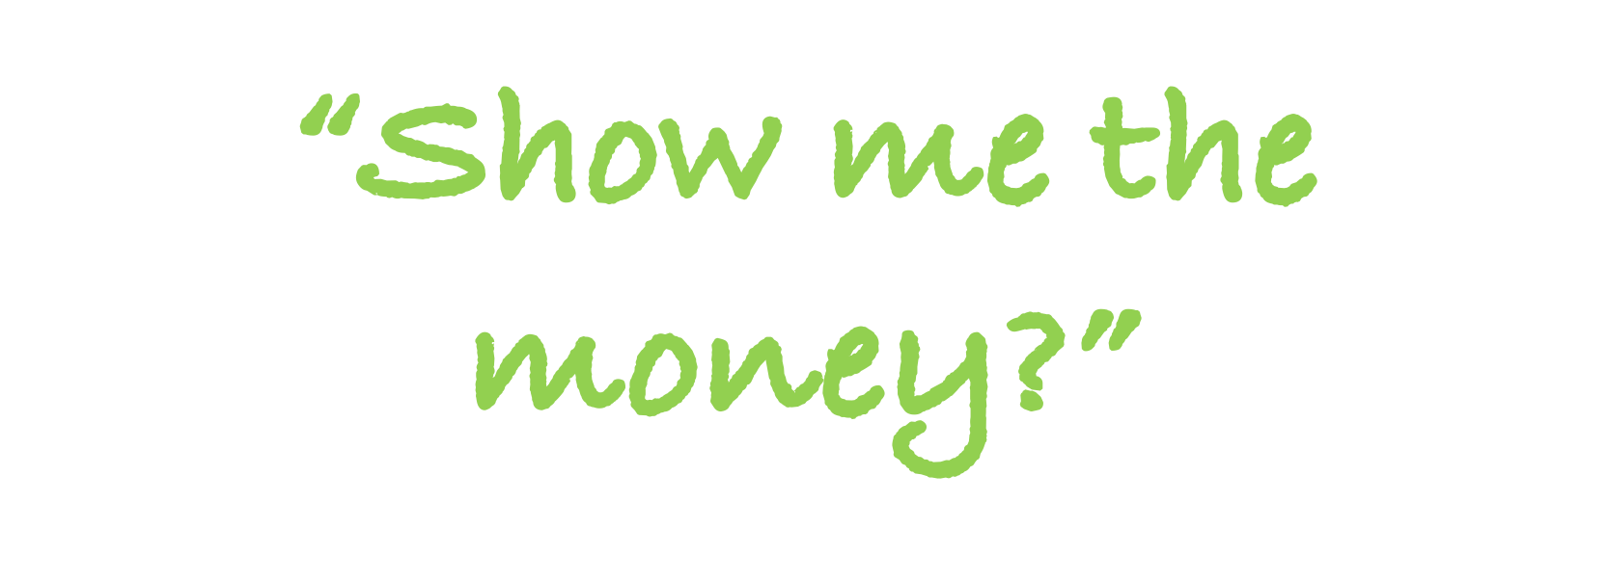
QUESTIONS
KILLER

Slide 55




PROFIT
Notes:
Facts

Slide 56

NEW
50
per unit | NOW
REVENUE | 100
COSTS | 40
PROFIT | 60
NEW
100
50
40
Profit % | 60
40

Slide 57

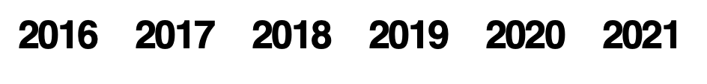
per unit
REVENUE
COSTS
PROFIT
NEW
100
50
40
SOLAR COST DECLINE
NOW
100
40
60
WRIGHTS LAW
50 ($3.18)
Index (gross $/watt)
-20%
Cost/unit
40 ($2.66)
Profit %
40
60
Notes:
It is named after Richard Swanson, the founder of SunPower Corporation, a solar panel manufacturer.^{[2]} The term Swanson's Lawappears to have originated with an article in The Economist published in late 2012.^{[3][4]} Swanson had been presenting such curves at technical conferences for several years.^{[5]} It is a misnomer in that Swanson was not the first person to make this observation.^{[citation needed]}
Swanson's law has been compared to Moore's law, which predicts the growing computing power of processors. Swanson's Law is a solar industry specific application of the more general Wright's Law which states there will be a fixed cost reduction for each doubling of manufacturing volume.

Slide 58
PROFIT FROM
SUSTAINABILITY
DEFINE YOUR ROLE
INNOVATING & MAKE BOLD CLAIMS
SHOW ME THE MONEY

Slide 59
Thriving Together in 2023
#AISThrive

Slide 60
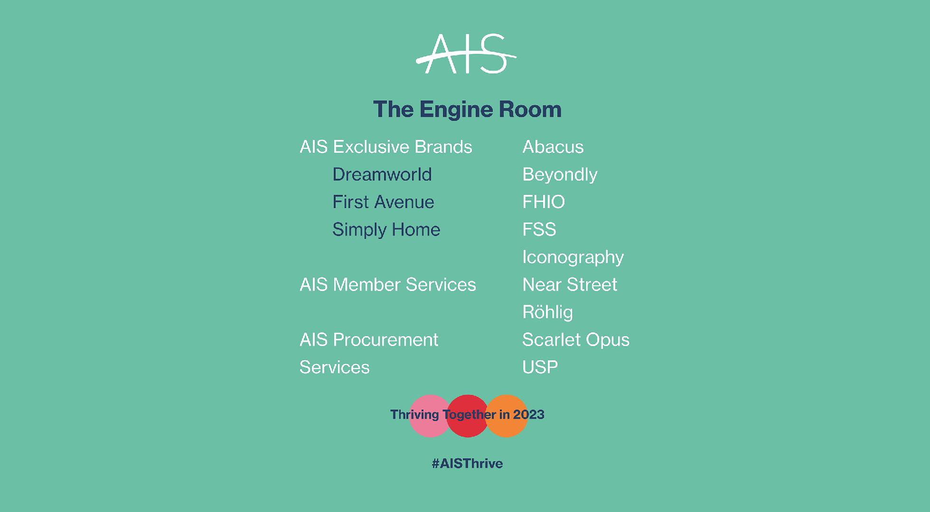

Slide 61
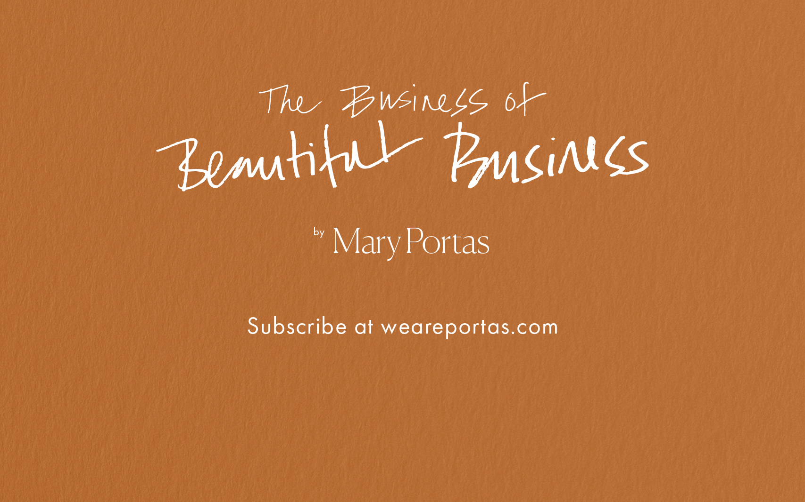

Slide 63
Thriving Together in 2023
#AISThrive

