Slide 1
Thriving Together in 2023
#AISThrive

Slide 2
Thriving Together in 2023
#AISThrive

Slide 3

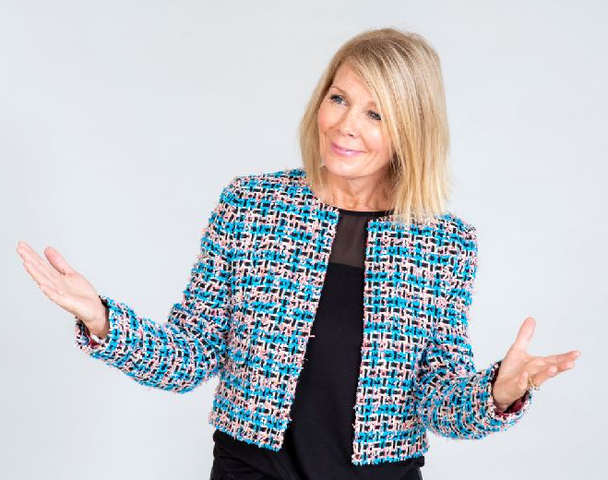
Siân Jones
Master of Ceremonies

Slide 4
Thriving Together in 2023
#AISThrive

Slide 5

Looking After You Today
#AISThrive

Slide 6



Slide 7
Making The Most Of Today
#AISThrive

Slide 8
Survive, Drive,Thrive

Slide 9
We've Survived …..
Financial Stability
Strategy Development
Re-organisation and Reinvigoration
Member Communication
Strategic Investment in Technology
Increased Sector Coverage

Slide 10
Years 1 – 3
"Great Place to be a Member“ Action Plan . In Place
"Good, Better, Best" Standards, Efficiencies and Ways of Working
Plans in place and actions ongoing
"Good, Better, Best" Services, Product & Merchandise Standards Actions taken and work ongoing
Supplier Strategy & Development e.g. Joint Business Plans
In Place
Communication, engagement & networking e.g. Trade Shows, Business Briefings, Strategy Groups, Visits, Webinars, The Hub
In place and will develop continuously with your support
New initiatives to improve online, events and property
Ongoing
Growing member and supplier base
In Place
We're Driving.....

Slide 11
Departmental Structures; Job Descriptions; pay rates; benefits; ways of working to enable consistent, fair, flexible and productive working. Plan in place and actions ongoing
Determine ESG strategy
Just starting
Development of the People agenda – Making AIS a "Great Place to Work“
Plan in place and actions ongoing
Financial and trend analysis to enable people to make the highest quality commercial
decisions – Finance, CENPAC and RBM
Continuous development in place
Development of growth targets and KPI measurement tools
All areas defined and starting to use
We're
Driving.....

Slide 12
Finance Focus

Slide 13
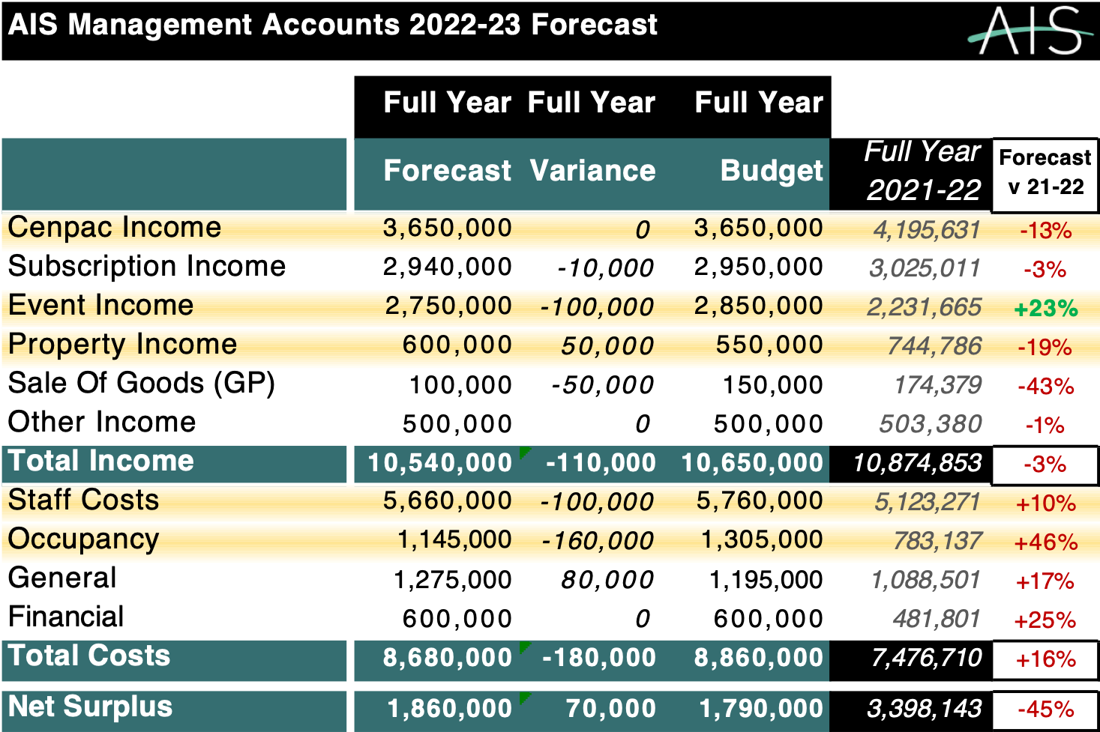
Notes:
AIS Management Accounts: 2022-23 Forecast

Slide 14
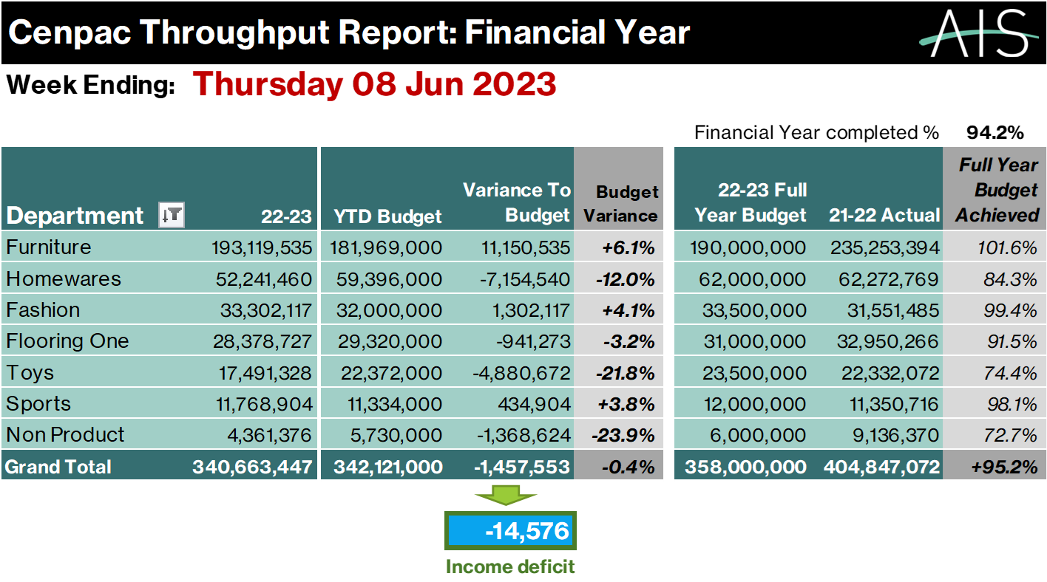
Notes:
CENPAC Throughput Report

Slide 15
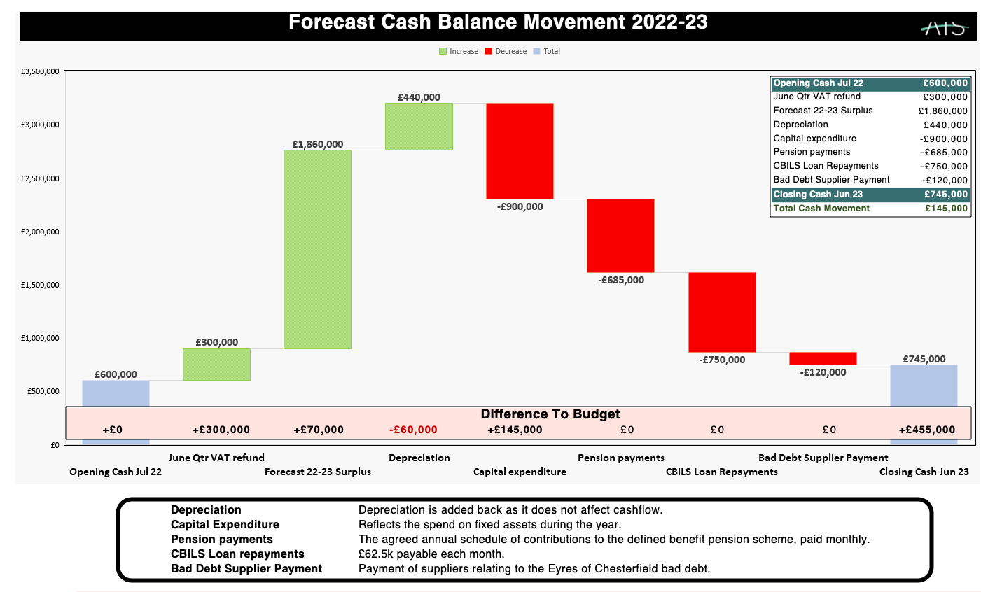
Notes:
Forecast Cash Balance Movement 2022-23

Slide 16
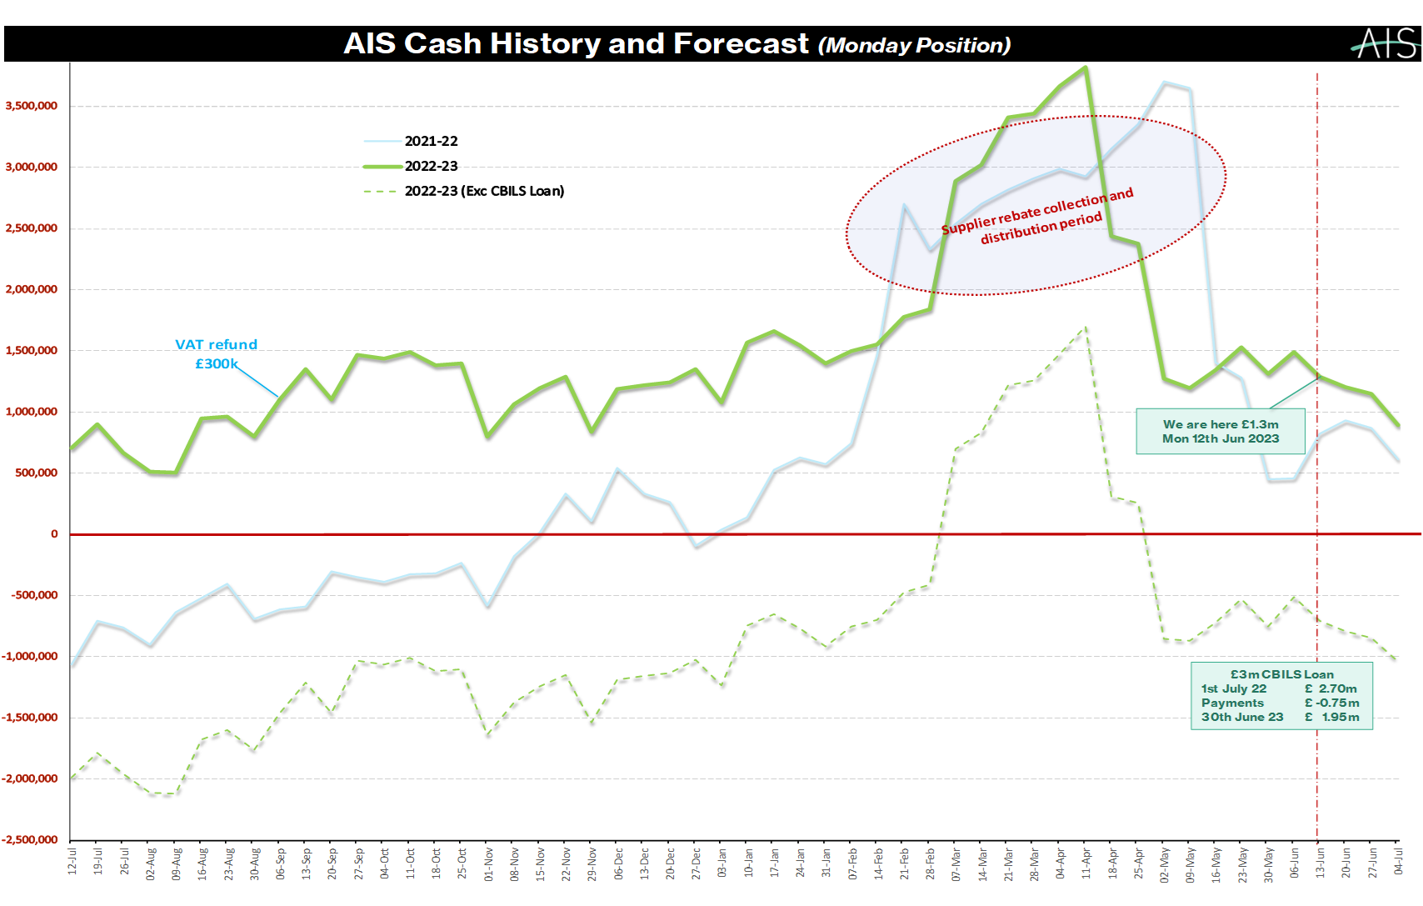
Notes:
AIS Cash History & Forecast (Monday Position)

Slide 17
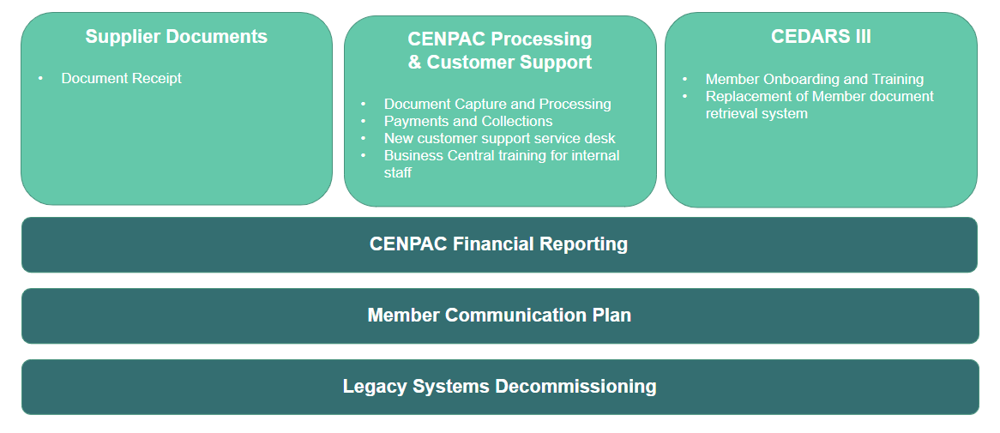
CENPAC Strategic Investment

Slide 18
Cenpac Supplier agreement
In the event of insolvency for a member, we guarantee to pay the suppliers for any unpaid amount excl. stop notes and forward dated invoices.
A formal Member Security Policy approved by Board, November 2021.
Monitoring of every Members’ financial viability against set KPIs as credit insurance not possible.
Since the roll out eight new securities agreed and in negotiation with two other members.
We currently have security from 31% of the members.
All new members to provide security before a Cenpac account is opened.
Financial Stability

Slide 19
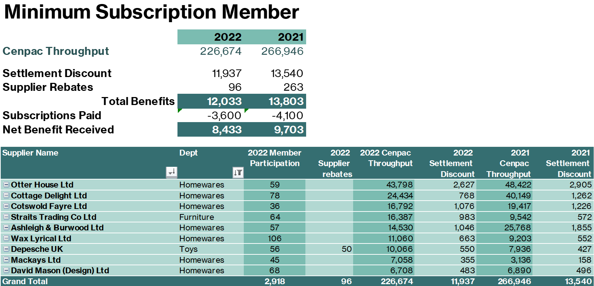
Better Financial Information
2022 Member Statement

Slide 20
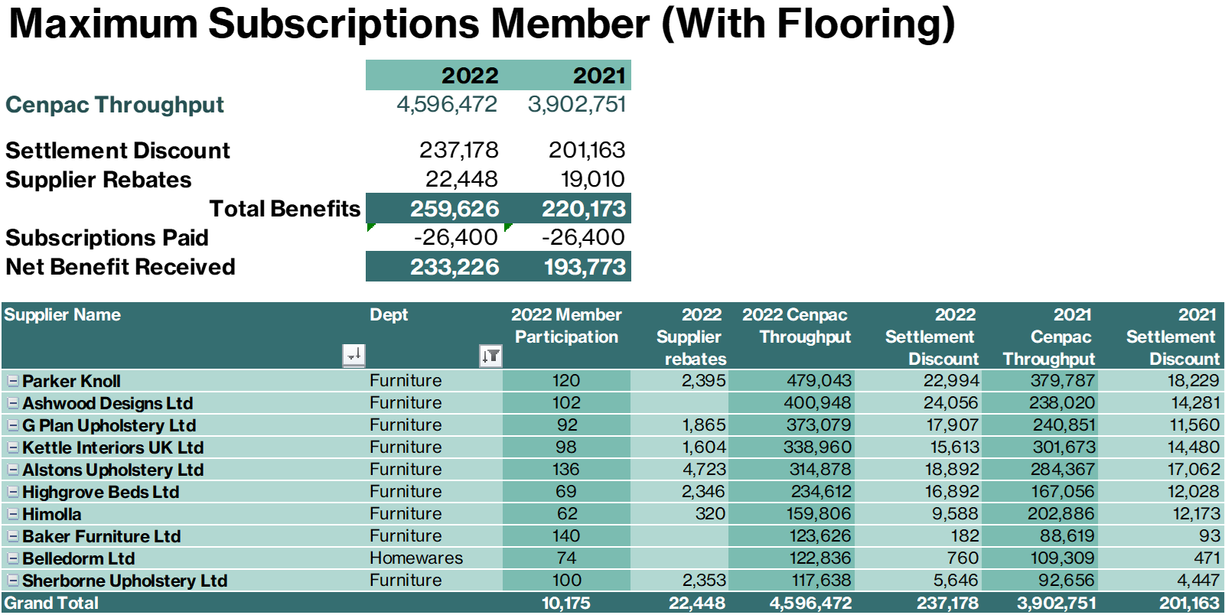
Better Financial Information
2022 Member Statement

Slide 21
...Financial Decision Making
Improved…
Financial Skills
....Financial Reporting
...Financial Stability

Slide 22







Customer
focused
culture
Collaboration
It's all about engagement
and teamwork
Creativity
The 7 C’s
Clarity
Commercial
Continuous improvement
and agility
Communication

Slide 23
Let's Thrive!

Slide 24

Notes:
In 1888 a well do gentleman was sitting on a balcony of a members club in Paris, enjoying a cup of coffee in the morning sun, reading the newspaper. Born in Stockholm, raised in St Petersburg, fluent in six languages, interested in literature and the arts and owner of 100 factories across Europe, he was successful beyond most peoples wildest dreams.
What happened next was to change his life forever

Slide 25
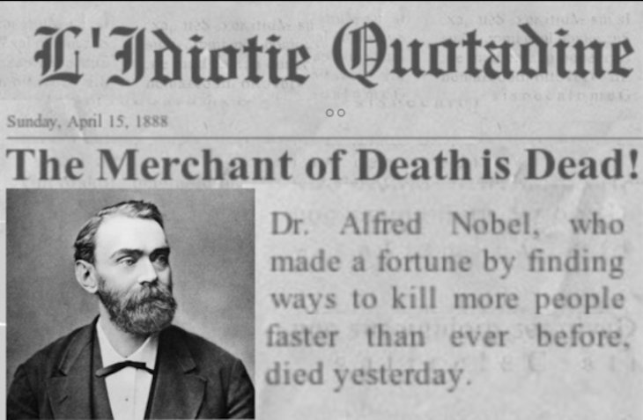
Notes:
As he read the newspaper he came to the obituary section and there to his horror was his life laid out before him, he was referred to as “the merchant of death..."
The newspaper had mixed him up with his, also successful, brothers death and printed the wrong obituary. What he read deeply trouble him.

Slide 26
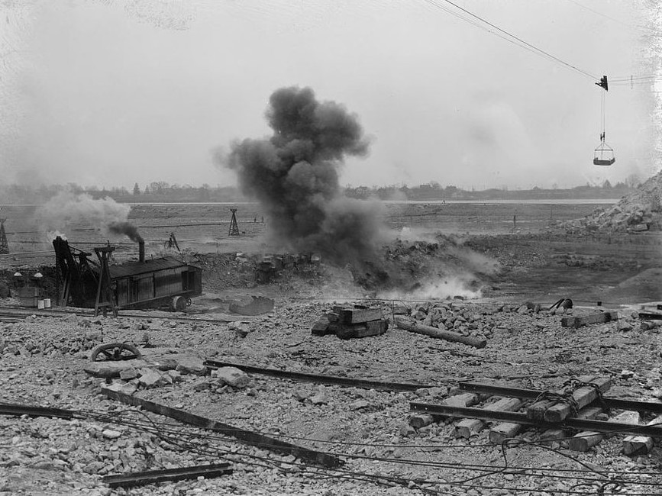
Notes:
Alfred Nobel was the inventor of dynamite, but he had always envisaged that these explosives would be used to the benefit of mankind… mining, building canals and roads, unfortunately, he was wrong!
Nobel vowed that he would not be remembered as such and set about leaving his immense fortune to foster science, literature, and peace. He changed the future, Alfred Nobel created and is remembered for The Nobel Prizes, awarded annually in Stockholm since 1901.

Slide 27
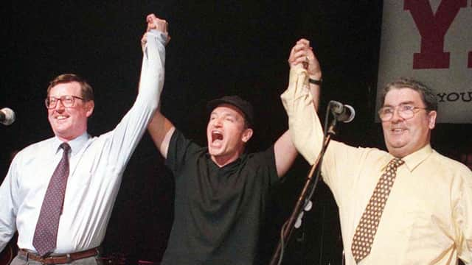
Notes:
Nobody now talks about Nobel the merchant of death, people talk about what the Nobel prizes stand for what they recognise and promote, particularly peace. Here from my own part of the world David Trimble & John Hume going on to win the Nobel peace in 1998 in recognition of the work they carried with the Good Friday Agreement and not inconsiderable risks they took.

Slide 28
Neville Moore
Managing Director
Ulster Stores Ltd
Chairman AIS
Notes:
Good morning I am Neville Moore, owner and Managing Director of Ulster Stores and current Chairman of AIS.
There have been some fantastic chairs of AIS, actually 15 since we joined… there was however a degree of concern when accepting the position, as typically its something that you do towards the end of your career! “Google Search”
Some of you will know me, some may not, but for me AIS has been a huge part of our own businesses growth and my own personal development, so as well as an honour, another very good reason to accept the position of Chair and hopefully give something back to the association.
When we approached AIS regarding membership in the 1980s we were a very small department store business… with no balance sheet, explained to me at the time because we made all our own fixtures and fittings!
I can still remember Tom Sheward (of Sheward House fame) coming for a visit and explaining what Membership of AIS could do for us…. It was an entry to a club that not only combined buying power but also access and networking with other successful independent retailers. It was one of the best business decisions we ever made!
Young and enthusiastic I threw myself at it, the trade shows, the regional meetings, the conference, strategy committees… and yes the odd late boozy night, where I have made lifelong friends. I believe our AIS membership has made me a better person and we are a much better business for it.

Slide 29
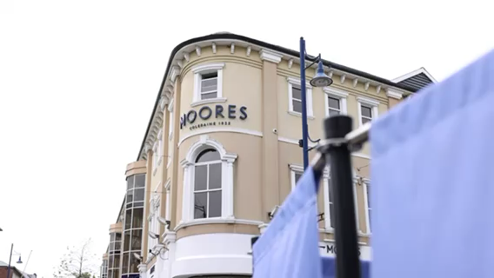

Slide 30
Notes:
Covid, as for most, really tested us, but also presented opportunities. After the initial phase, we realised that it was time to stop digging and start planning on how to capitalise on these opportunities. That planning process included talking to and visiting other AIS members. The result was what we call SEED, a plan to guide us through the next 5 years and beyond.

Slide 31
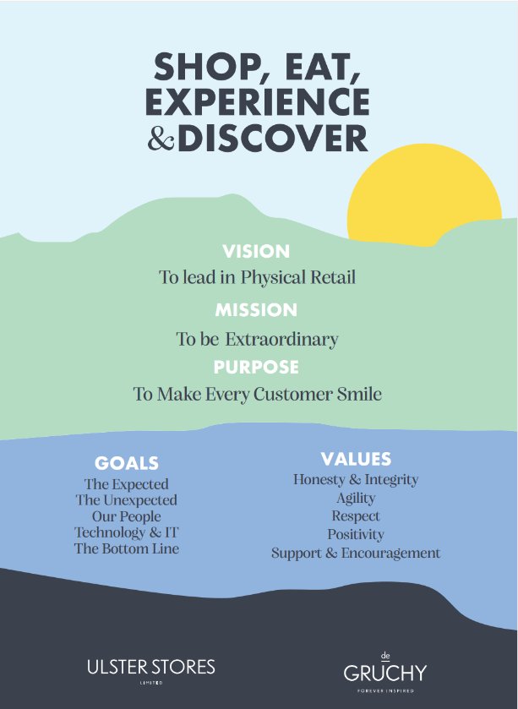
Notes:
The Vision – Where are we going – To lead in physical retail, giving a unique experience, building a community that values us beyond shopping
The Mission – How are we going to get there – The be extraordinary, Shopping, Eating, Experiences and Discoveries (that bring a smile)
Purpose – Why are we here? – Why do we come to work? To make our customers happy, to make every customer smile
We have 5 strategic goals, but we are really excited about the unexpected -
“to bring a community together with unique or best in class services and discoveries, that tickle the senses and make our customers feel good about themselves and us.

Slide 32
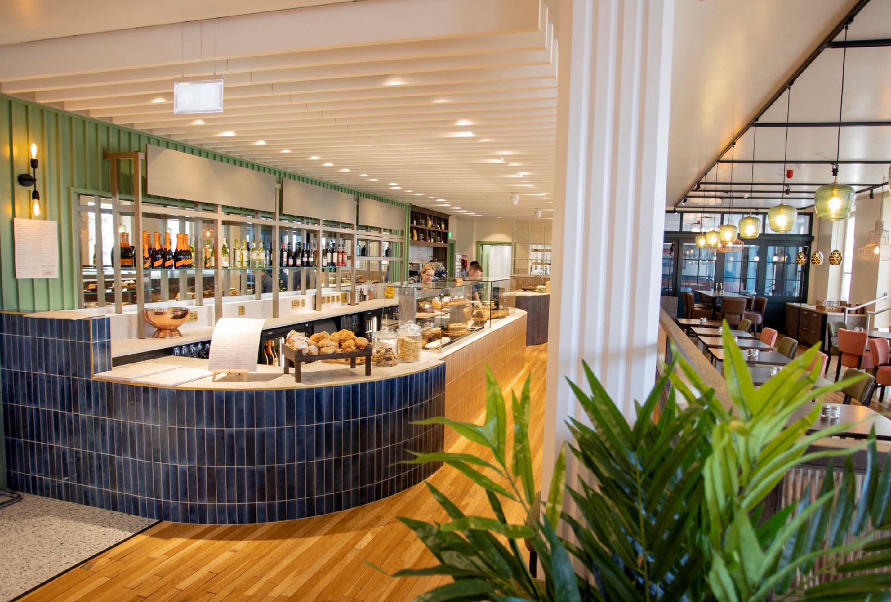
Notes:
As part of that unexpected goal we have a renewed focus on hospitality and have just launched a new restaurant in our Portrush store, The White House.
The space breaks into 4 distinct areas, dining, conservatory, library and afternoon tea (to be launched this Autumn). This space is also multi functional and can be used for community events, brand workshops….
.
Again much of the inspiration for this came from other AIS members.

Slide 33
Notes:
We have never measured membership of AIS purely on the financial, that’s obviously really important……

Slide 34
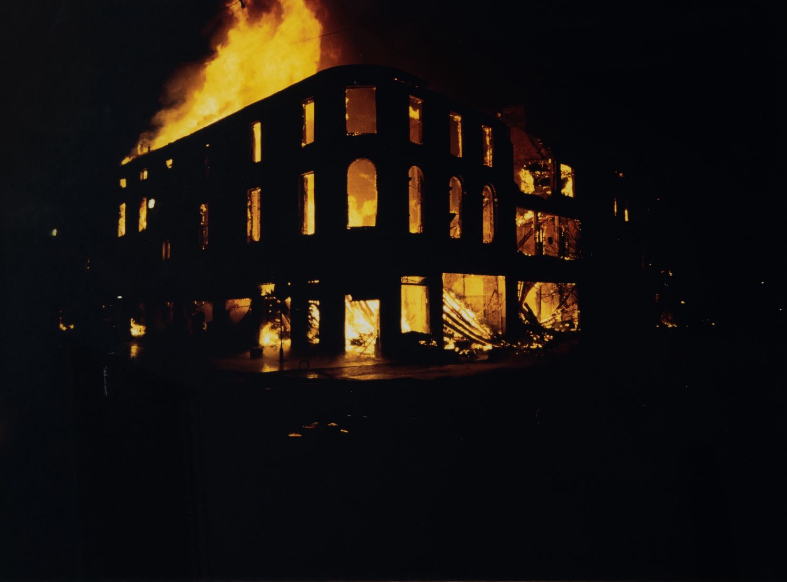
Notes:
On Friday 13th November 1992 we suffered a catastrophic loss in Coleraine when Moores was completely destroyed in a terrorist bomb attack. Thankfully as it was late and no one was injured.
The first phone call that we made on Monday morning was to Austin Harper at AIS….. “ Austin we may have a problem with this weeks CENPAC!”
It’s at times like that you know how deep your relationship is.
For us that relationship is multi layered, being part of that club gives discounts, exclusives, own label, but also relations, connection and learning. It also comes with some responsibilities.

Slide 35
Our Code of Conduct
Support AIS
AIS Agreements
AIS Communications​
Notes:
We have those in our code of conduct but to me its common sense -
that you give whole hearted support to AIS, including attendance at shows
don’t undermine AIS agreements
respond to AIS communications in time.

Slide 36
Notes:
When Covid came along AIS was actually in quite a vulnerable position.
During that period we were very fortunate to have had the exceptional services of Stephen McCammon of Menarys as Chair. Battling, like all of us, with his own Covid business challenges, he found time to handle the succession process within AIS and the short version of that is “it wasn’t easy”, then to ensure that AIS could firstly survive and then be in a position to drive. Stephen even agreed to extend his term to see the job through.
We haven’t had a conference for several years, so there hasn’t been an opportunity to thank Stephen in this forum and indeed he didn’t get the opportunity to enjoy the stage, as I am today. Stephen please stand up…can you please show your appreciation. I hope that when the history of AIS is written Stephen that their is a chapter there on you.
AIS is a very different organisation to what it was a few years ago. The management style is very different, much more open and I think that the culture is changing to reflect that and it was another reason that I was happy to accept the position of Chair. I think it was really evident at last years strategy session with a completely different atmosphere and level of participation from the AIS team. I am delighted that we have some of the wider AIS team here today as well.

Slide 37
Being Independent
Notes:
We have a customer Danny O’Kane, who runs a reclamation business locally and when you phone up to Danny you get the following message -

Slide 38

Independent Retail is Thriving

Slide 39
Being Independent
Notes:
I love it, to me it captures what it is to be an independent business, that free spirit, the ability to do it do it your way and have some fun at the same time.
I believe passionately in independent and physical retail. To me its pretty obvious that there are going to be fewer retailers, but those that remain will out of necessity need to be better… and what better than a well run local independent.
You are probably wondering at this stage were Alfred Nobel comes into the picture ….. and indeed I am starting to wonder myself.

Slide 40

Notes:
But for me the Nobel story is really about ambition and the future.
So I would challenge everyone here today, no matter what stage of your career or journey you are on, that YOU CAN CREATE A DIFFERENT FUTURE, for you, your career, your business and your relationship with AIS.
If we want to survive, thrive and drive then I believe that we need a strong AIS, but AIS also need strong members….. That means we need to be bold and ambitious, with aspirations to create a different future, work with each other and work with AIS.

Slide 41
NEW CHALLENGES!
Notes:
One of the losses, or new challenges, from Covid for AIS has been the break in physical gatherings and drop in engagement. That’s not to say that all was perfect with shows, conferences, regional meetings and communications, but we do now need to find a way to make it better.

Slide 42
Engage with AIS
“Make a commitment”
Notes:
I would ask you to make a commitment, a pledge, here today to do something to support and engage with AIS –
!

Slide 43
To attend a regional meeting
Join a strategy group
Volunteer to sit on the board
Create your own network or support group
Use the HUB, leave a comment
Attend an AIS trade show
Engage with AIS
Notes:
To attend a regional meeting (nm to say even better offer to host a regional meeting)
Join a strategy group
Volunteer to sit on the board (NM to say its 4 meetings a year and two of the are virtual!)
Create your own network or support group
Use the HUB, leave a comment
Attend an AIS trade show
We are all busy people but I can give you a guaentee, you will get far more out than you put in
As part of this club, you are a member of the UK and Irelands leading fashion, home, leisure, buying and services group for Independent retailers…. Don’t take it for granted

Slide 44
Stronger Together…
Notes:
We are stronger together!

Slide 45
Question Time

Slide 46
Thriving Together in 2023
#AISThrive

Slide 47
eCommerce flatters to deceive

Slide 48
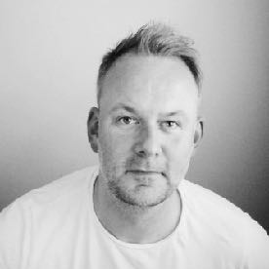
PepsiCo
Calvin Klein
Earths Secret | Shaws | Vida Living
Consultant
About me
Crua Outdoors Tranquillity TRC Solutions
Director
Dublin City University
Global Economic Forum Irish Marketing Institute Tralee Chamber Commerce
Training
6'2
Wife and 3 kids - live in Kerry, Ireland Trained as a butcher
Claim to fame
Loves a Belgian beer
Personal
20 years experience
All verticals
Likes to shop in person
Runs a conference
eCommerce

Slide 49
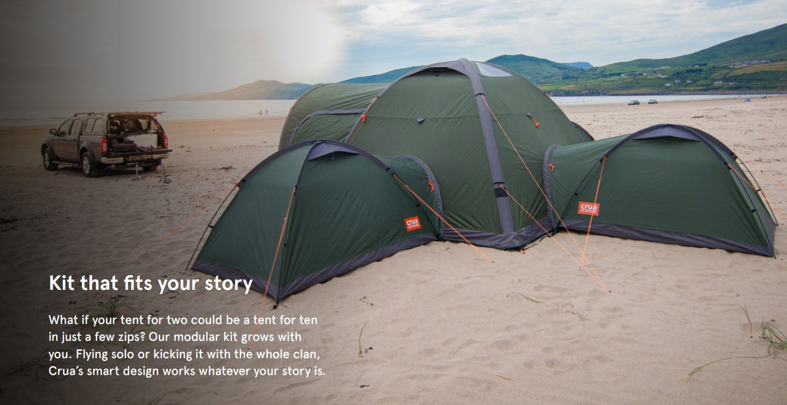

Slide 50
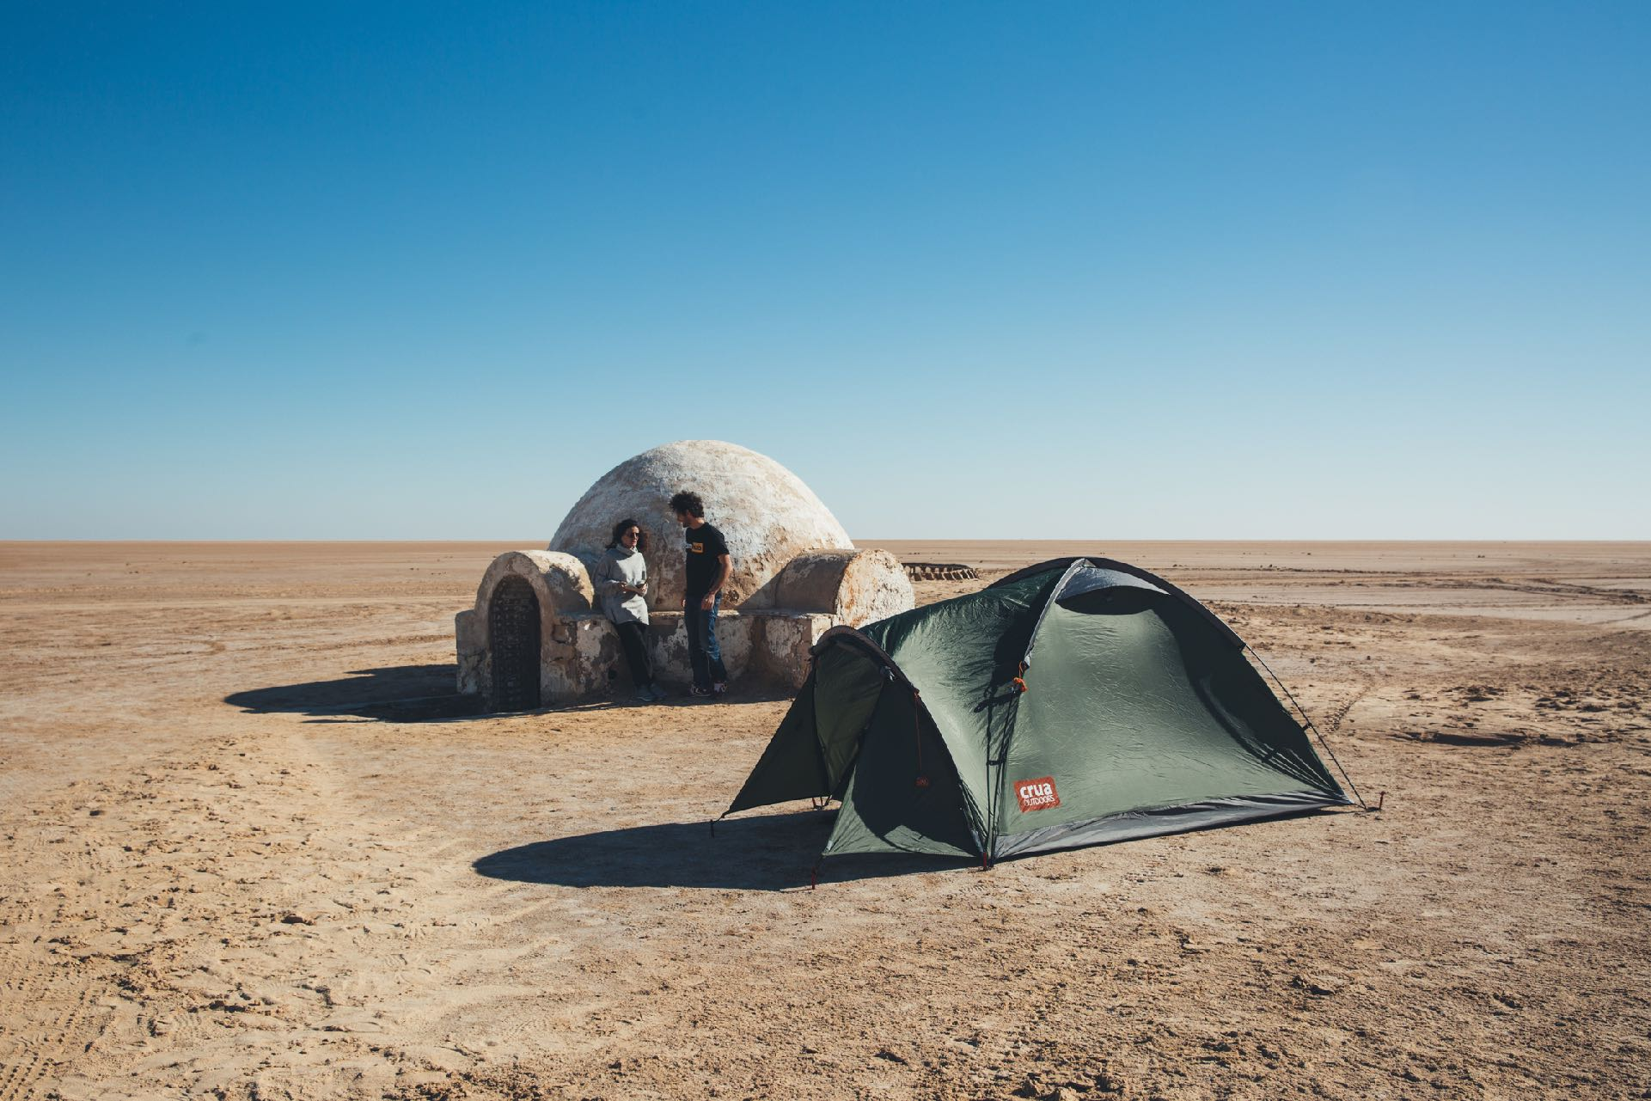

Slide 51
#1
How do we feel about eCommerce in 2023?

Slide 52
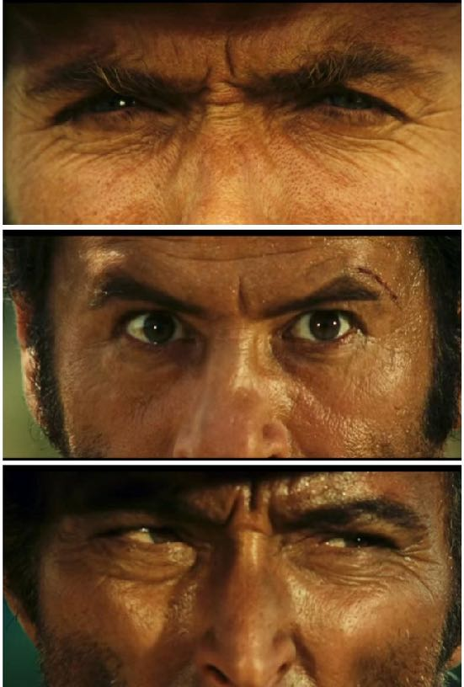
the state of ecommerce for the
Independents
A view from the front line

Slide 53
Let's talk Clint Eastwood Movies
New Customers
Future Customers Keeps suppliers happy Feels right
The Good
Competitive
Distracting
Being forced into it
Intangible
The Bad
Competitive Expensive Overwhelming Returns
So many choices
The Ugly
A few
dollars more
Advertising costs going up Inflation
Fight for every dollar spent
Operational challenges
Data collection is tough
Skills vs Requirements
Time consuming
Ever changing
Big f*ckin Black Box
Any which way you can

Slide 54

COVID19
Ecommerce Growth Drivers
Choice, Competition, Cost, Customer Experience
Proliferation of media channels –
new acquisition tools e.g. FB Media
Cheaper platforms – Shopify, Big Commerce
Digital ubiquity
1
2 3 4 5

Slide 55
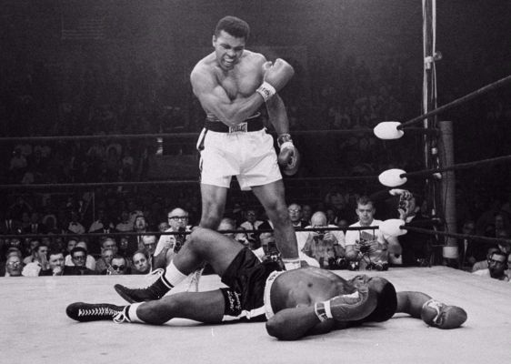
“Just because you think you can box, doesn’t mean you get in the ring with Ali”

Slide 56

You are being told to look in the wrong areas
Diagnosis Strategy
Brand Positioning
Product & Proposition
Product / Brand Activation programmes
Execution in Market - Creative, the media and the assets used

Slide 57


“Strategy is designing a way to deal with a challenge”

Slide 58

What is a Strategy?
“A strategy is a coherent set of analyses, concepts, policies and actions that respond to a challenge”

Slide 59

Diagnosis
What’s in a strategy?
define or frame the nature of the challenge
Approach
creating an approach based on the insights learned
Approach + insights
provide guidance for action
Actions
are the appropriate, coherent set of tactics.

Slide 60

The Real Problem
‘Strategies’ & ‘tactics’ as terms are used interchangeably
The fragmentation of channels
Resources are not aligned with strategy or objectives
The emphasis on tactical plans

Slide 61
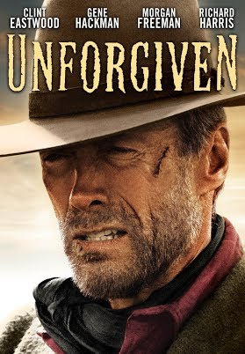
Time is a healer
A view from the front line

Slide 62
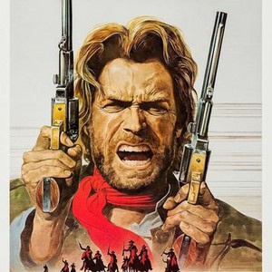
But, ecommerce is not an outlaw
Let's see where it goes

Slide 63
#2
What are the business models? There is not only 1

Slide 64
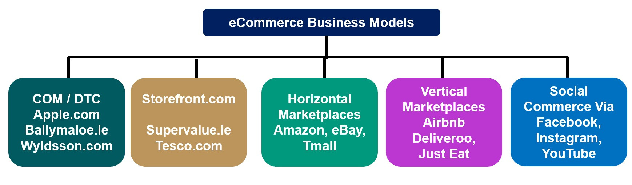
Social
Commerce V
Facebook
Instagram
YouTube
COM / DTC
Apple.com
Ballymaloe.ie
Wyldsson.com

Slide 65

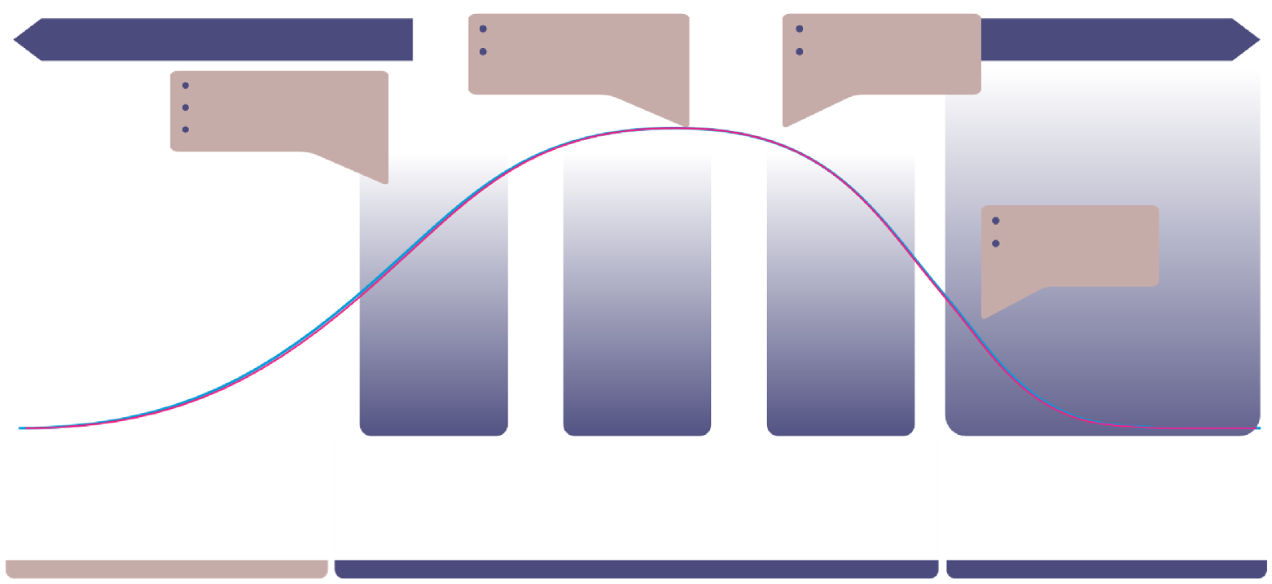
Marketplaces and why they work
*** CHECK ***
Understand eBay
Report overview
Opportunities across the full product lifecycle
Drive Volume
Clearance
Price High
Recovery Proposition
Traffic Recovery
Price Low
Awareness Acquisition Volume
Sales
Volume
eBay marketplace
CS
Recovery Rate
COVID-19 has led to an increase in the number of small business sellers on eBay, which rose by 34% from April 1 to September 30,2020.
eBay sellers
Of all eBay domains, seller profiles on ebay.com generate the highest GMV on average, namely US$3 million in 2021.
Launch
1
In season
2 Promotion
3 Terminal
4 Dead
4
Drive Volume
Clearance

Slide 66

Decisions, Decisions, Decisions - It is confusing
A view from the front line

Slide 67

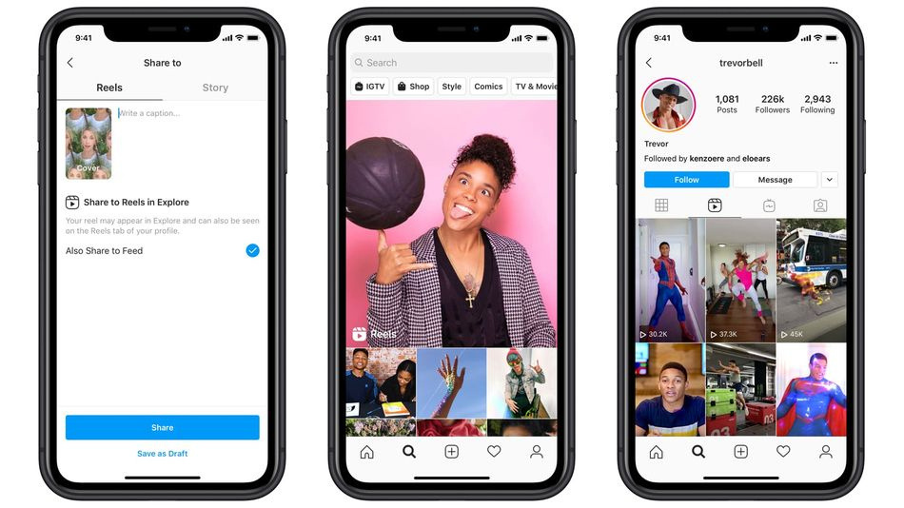
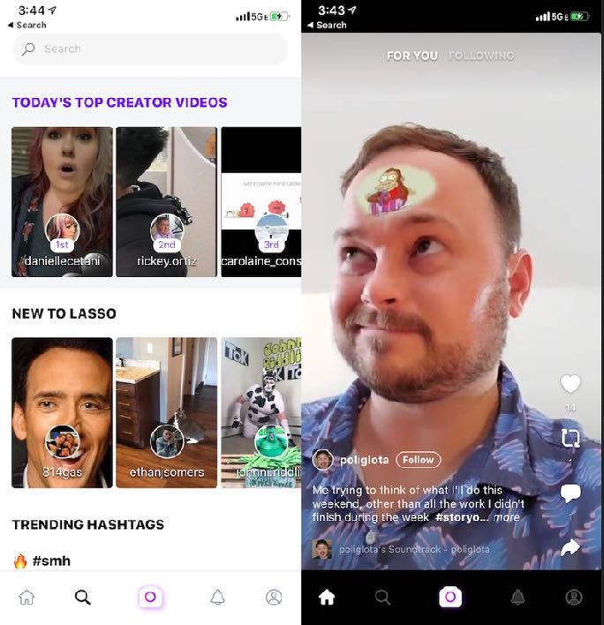
The next Frontier for eCommerce – integrated in Social
www.vinnyandco.ie

Slide 68
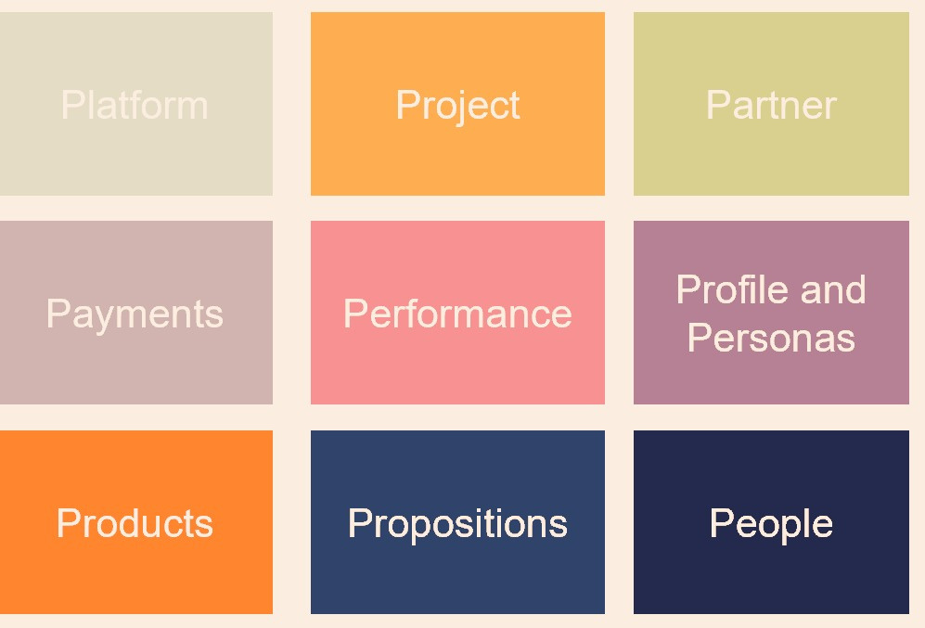
The 9 Ps and Me

Slide 69


Slide 70
Thriving Together in 2023
#AISThrive

Slide 71



Slide 72















CLIENTS

Slide 73
Social media can be the first step
In a lasting relationship
With your customers

Slide 74
First touchpoint
Move the dial
Create connection
THE DISCOVERY ENGINE
New prospects
Drive demand
Generate awareness

Slide 75
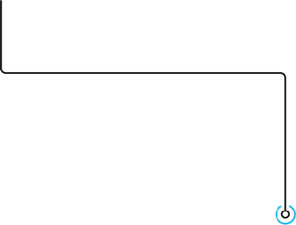

PAID SOCIAL
GENERATE
INCENTIVISE
Web traffic
Store visits

Slide 76
SPARK A CONNECTION
THAT BRINGS THE USER
Into your world

Slide 77

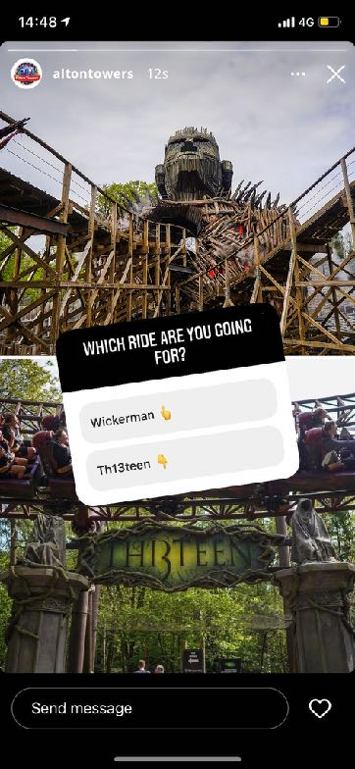
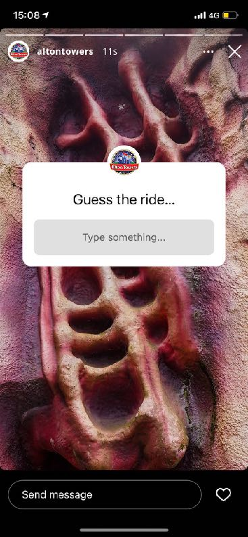
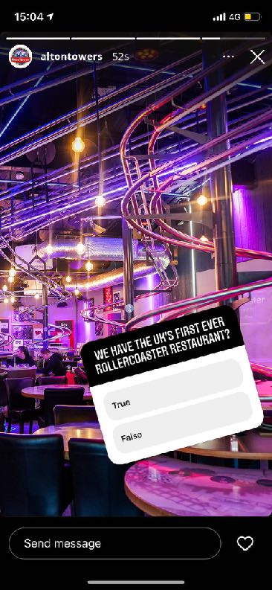


Slide 78


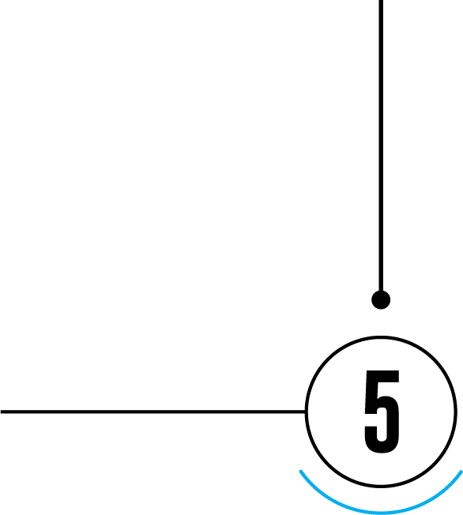
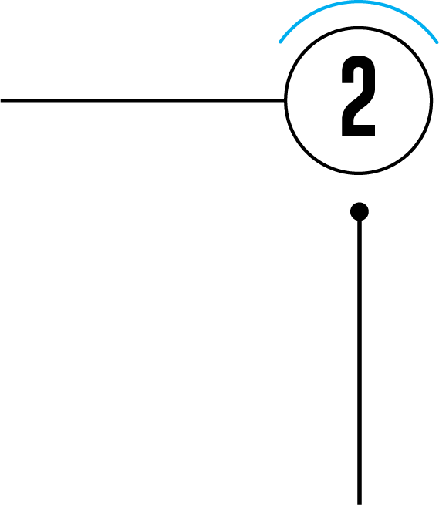

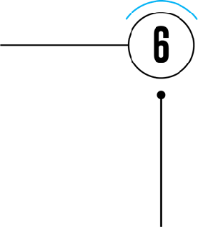


SOCIAL AD
VISITS STORE
EMAIL OFFER
2nd interaction
4th interaction
6th interaction
1st interaction
3rd interaction
5th interaction
IN-STORE ONLY OFFER
SHARES EMAIL IN STORE
REPEAT PURCHASE

Slide 79
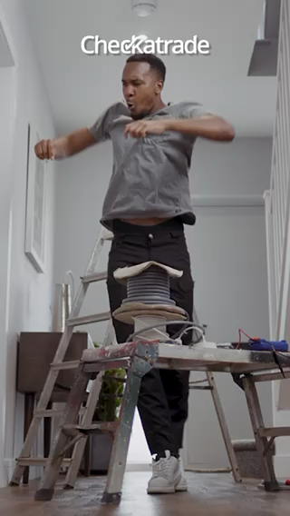
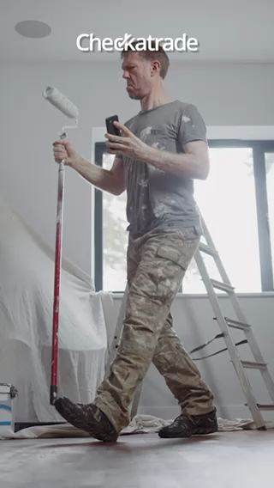
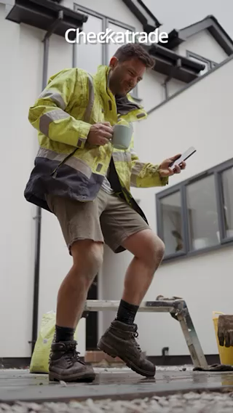

Slide 80
Organic CONTENT
EMAIL LEAD GEN AD
SOCIAL DPA
2nd interaction
4th interaction
6th interaction
1st interaction
3rd interaction
5th interaction
Follows BRAND
CLICKS THROUGH EMAIL to site
CONVERTS

Slide 81

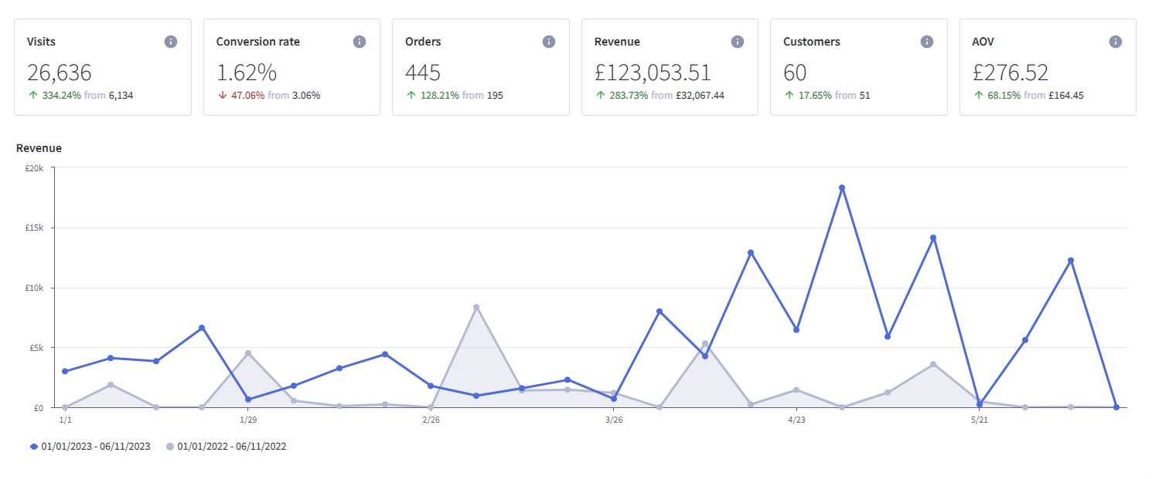
CASE STUDY
£3,500 media spend per month
335% + YoY traffic
128% + YoY orders
284% + YoY revenue
Paid social delivers 75% of all traffic

Slide 82
results
500k
UNIQUE REACH
35,336
Website visits
445
ORDERS
5.8
EROAS
£47.19
CPA

Slide 83

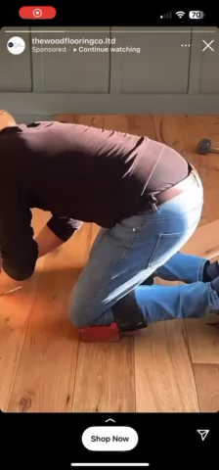

322k impressions
17,500 Website visits
46 Purchases
£28k REVENUE

Slide 84
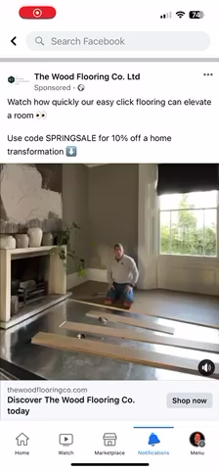
22m impressions
9,346 Website visits
28 PURCHASes
£17k REVENUE

Slide 85
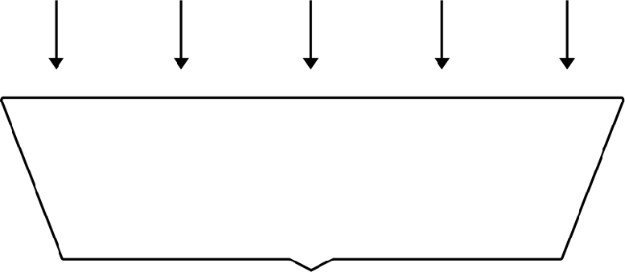





AWARENESS
Paid & organic social
Compelling content
ENGAGEMENT
PPC & email
Strong offers & messaging
action
Website & instore
Quality product & excellent service

Slide 86


KEY TAKEAWAYS
Online experience is as important as instore
Create connection with compelling content
Authentic platform first content
Think of social as a powerful first step
Data capture is key

Slide 87
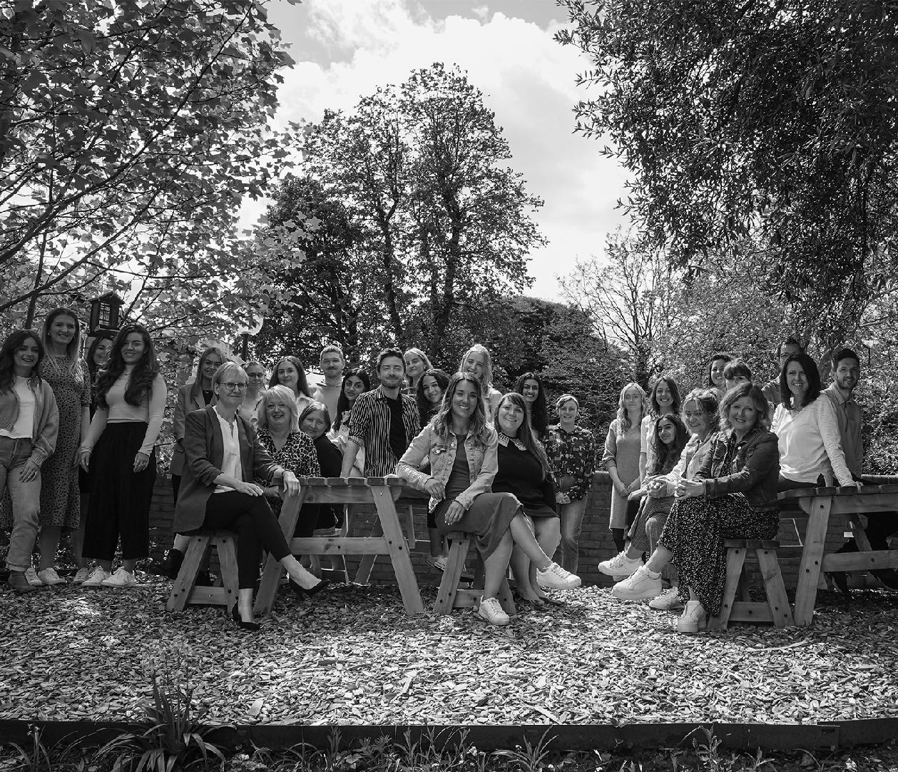
THANK YOU

Slide 88
Thriving Together in 2023
#AISThrive

Slide 90
INFLUENCER
MARKETING

Slide 91















ABOUT ME

Slide 92
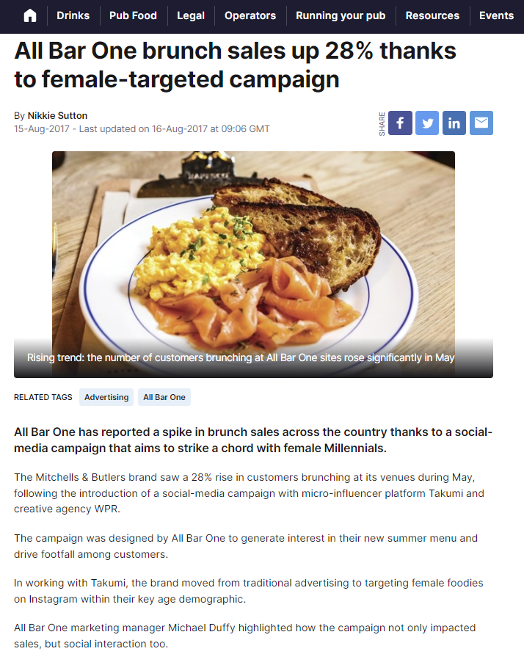
Our experience

Slide 93
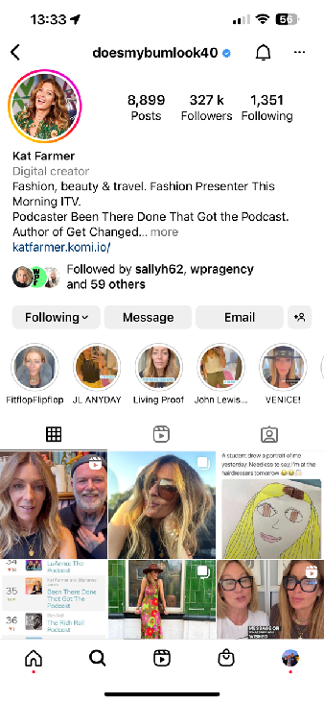

100K followers
9% engagement
2,000 clicks to site
X3 ROI

Slide 94
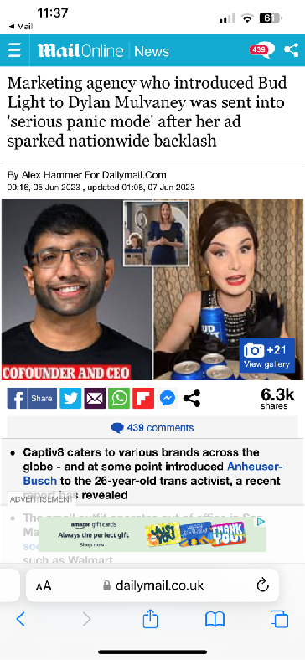

Slide 95
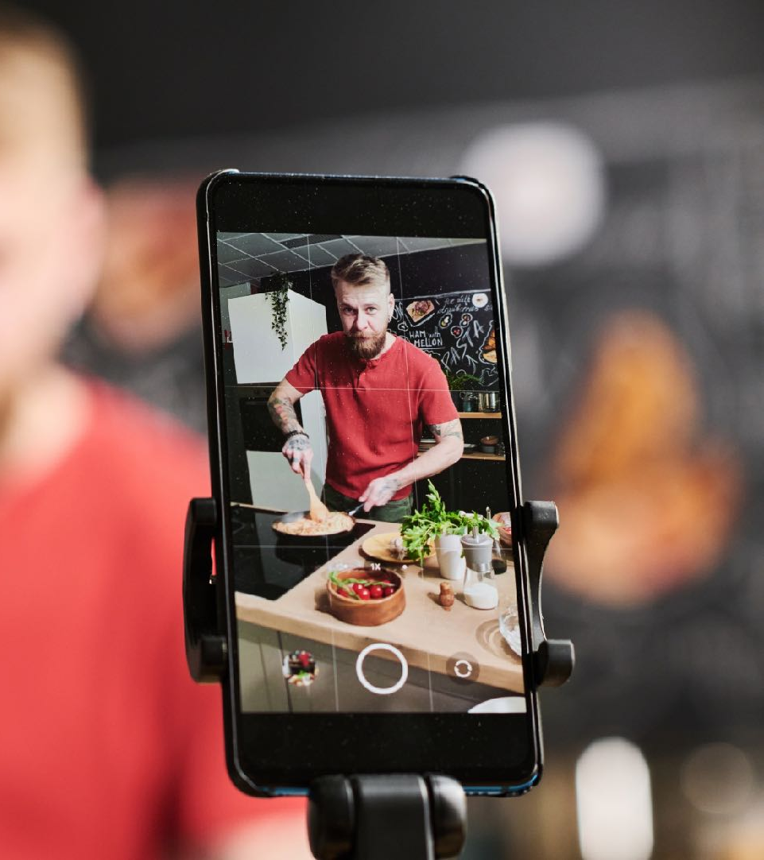


How to work effectively WITH INFLUENCERS
Notes:
Work for new news, but can give longevity to products or brands which journalists wouldn’t entertain as it’s essentially a paid partnership

Slide 96
1.
Understand influencer types
2.
FIND THE RIGHT CONTACTS
3.
Do plenty of RESEARCH
4.
Set the expectation

Slide 97
1. Understand influencer types
Micro
Mid
Macro
Celeb

Slide 98
Micro influencers on Instagram achieve
AN AVERAGE ENGAGEMENT RATE OF 3.86%
Vs just 1.21% of mega influencers
Notes:
Rises to 17.9% on TikTok

Slide 99
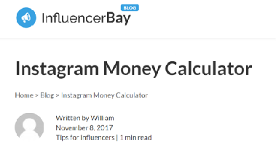
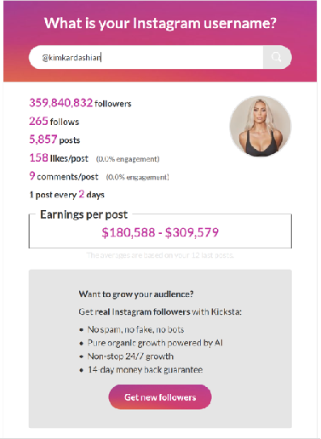

Slide 100
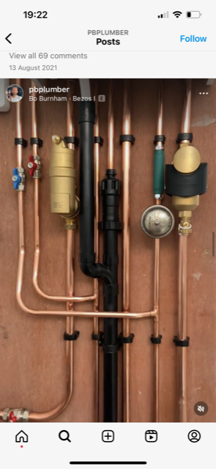
CAN BE BROAD OR NICHE

Slide 101


108
2. FIND THE RIGHT CONTACTS

Slide 102
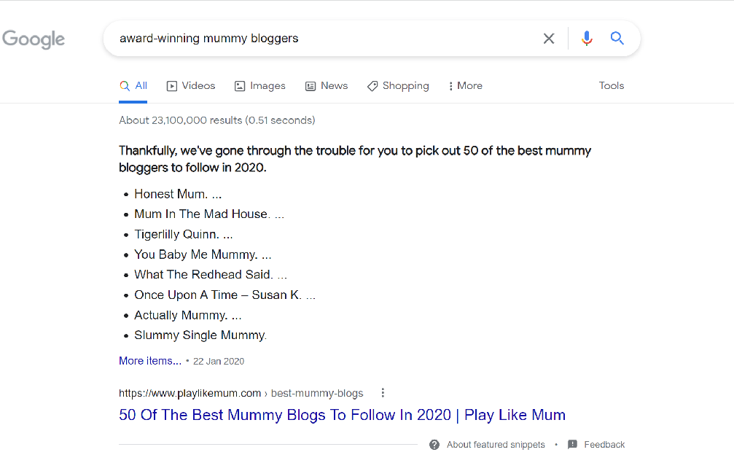

Slide 103

110
2. FIND THE RIGHT CONTACTS

Slide 104


Slide 105


Slide 106


Slide 107


Slide 108


Notes:
Great tip from Emma, will definitely be my first port of call moving forwards!

Slide 109



116
FIND THE RIGHT CONTACTS

Slide 110
Comprehensive vetting process
Previous partnerships
Metrics (reach, engagement, follower sentiment, audience data)
Interests and values
Controversial posts
Additional background checks
Enthusiasm!
DO YOUR RESEARCH

Slide 111


118
RESPONSE 1
RESPONSE 2

Slide 112
Provide robust brief
Include key information
Objectives, timings, handles and hashtags, key messages
Provide inspiration and references, but don’t dictate
Remember, the best partnerships are collaborative
SET THE EXPECTATION

Slide 113



Slide 114
Define terms of partnership
Include usage rights and period
Consider exclusivity arrangements
Set out approval process
Include termination clause
Cover ASA guidelines
Contract and usage

Slide 115
THANK YOU
jane@wpragency.co.uk

Slide 116
Thriving Together in 2023
#AISThrive

Slide 117


Slide 118



Slide 119


Slide 120


Slide 121


Slide 122


Slide 123


Slide 124


Slide 125


Slide 126


Slide 127


Slide 128
Question Time

Slide 129
Thriving Together in 2023
#AISThrive

Slide 130


Slide 131


Slide 132
Lunchtime
Sponsored by Lazy Linen
#AISThrive

